Slide 1
Learning as knowledge transfer….
Facilitating Knowledge Transfer in the Workplace:
capturing and distributing the knowledge of mature retiring managers
Llandis Barratt-Pugh Edith Cowan University

Slide 2
Learning as knowledge transfer….
The Issue:
Manager learning is instrumental
Lost knowledge as mature managers retire

Slide 3
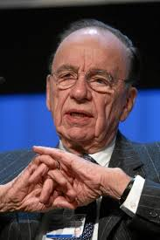
Learning as knowledge transfer….
What happens when they leave….

Slide 4
Learning as knowledge transfer….
400,000 mature baby boomer managers
are leaving the workforce
Taking their knowledge with them
Leaving fewer and less training successors to take over instrumental roles…

Slide 5
Learning as knowledge transfer….
They leave:
In organisational crisis
Illness and stress
Passed over and culturally distanced
Retiring at work
With less prepared and fewer successors

Slide 6
Learning as knowledge transfer….
Who will replace them?
What do they know?
‘Level three people taking on level 5 roles’
What is being done about managerial knowledge transfer in organisations?

Slide 7
A lack of knowledge….

Slide 8
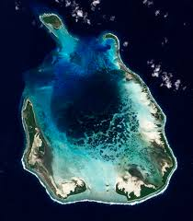
The Cocos Islands …. Greatest Australian Lack of knowledge – why we own Paradise…

Slide 9
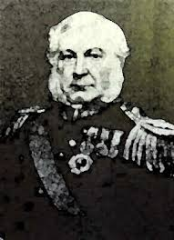
Capt Clunes – Ross & Capt Fremantle
After years of voyaging from Europe to Indonesia, Clunes Ross decides
to settle in the Cocos Islands but worries about the lack of protection the
British and Dutch are not interested.
1857

Slide 10
The Cocos Islands …. Greatest Australian Stuff Up – why we own Paradise….
A syndicate wants to farm on the Coco Islands and makes a request to the East India Company.
The British foreign office is called, the contact the Admiralty, who call Sydney to ask if they will take the Islands in the name of the King..
Cpt Fremantle sets off, claims the Cocos Islands with flags, a volley of shots and a proclamation.
He returns to find he has annexed the wrong islands – Cocos not Cocoa islands.
Entrepreurially – he puts a positive spin on his mistake and Western Australia eventually acquires a paradise in the Indian Ocean….

Slide 11
Passing knowledge can be very important….

Slide 12
Learning as knowledge transfer….
Knowledge transfer between managers – it is about:
Succession
Knowledge harvesting
Knowledge filtering and storage
Knowledge distribution
Knowledge embedding on the job

Slide 13
Learning as knowledge transfer….
Knowledge transfer between managers
Why is it important?
Managing critical manager knowledge
Retaining critical knowledge
Safeguarding sustainability and productivity

Slide 14
Learning as knowledge transfer….
Study Method
How do organisations harness the knowledge of their mature retiring managers? What are they doing/ How are they doing it?
Mixed methods
282 completed survey returns
interviews with 42 managers

Slide 15
Learning as knowledge transfer….
21% of the organisations did not believe that this was an issue that was worthy of strategic focus
Lack of time (98%) and other work responsibilities (96%) were cited as issues.
Challenging collaborative work projects (90%), and providing a flexible working environment (91%), were perceived as effective platforms for knowledge transfer and learning

Slide 16
Quotes from the field….
There are no identifiable KM practices in this organisation - We do not have specific knowledge management practices to specifically disseminate knowledge from mature managers - Nothing beyond formal and informal handovers.
We use our experienced people as ‘buddies’ to coach new people
We run "Communities of Practice" - online environments that collect and build on specific knowledge

Slide 17
Learning as knowledge transfer….
Messages for managers of learning
The findings present a disturbing picture
Instigate a Strategic Approach
Focus on succession planning - not IT storage
Craft a coalition of mechanisms - not ad hoc

Slide 18
Learning as knowledge transfer….
Learning for Researchers:
Do not only rely on industry produced issues
Focus on learning issues that impact on broader organisational productivity issues

