Slide 1
Exploring Disadvantage
Vocational learning in schools:
Past, present and future
Paper 1: Technical schooling: an historical perspective (John Polesel)
Paper 2: Innovative partnerships for VET in Schools – the impact of business partners (Gosia Klatt)
Paper 3: Preparing young people for occupations: current policy trends in VET in Schools (Kira Clarke)
Centre for Vocational and Educational Pathways, University of Melbourne
Discussant: David Gallagher, Victorian Curriculum & Assessment Authority
Nicky Dulfer and Kira Clarke
2011

Slide 2
Separating the sheep and the goats – the troubled history of VET in schools AVETRA 2015 Conference Melbourne 8-10 April
Professor John Polesel

Slide 3
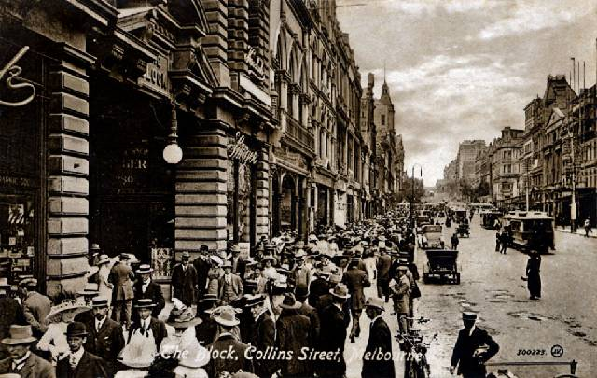
Melbourne 1901

Slide 4
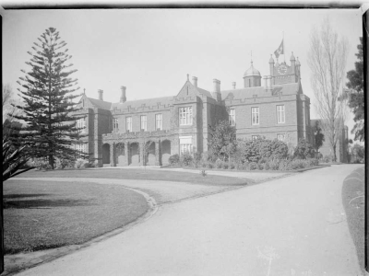
Melbourne Grammar School

Slide 5
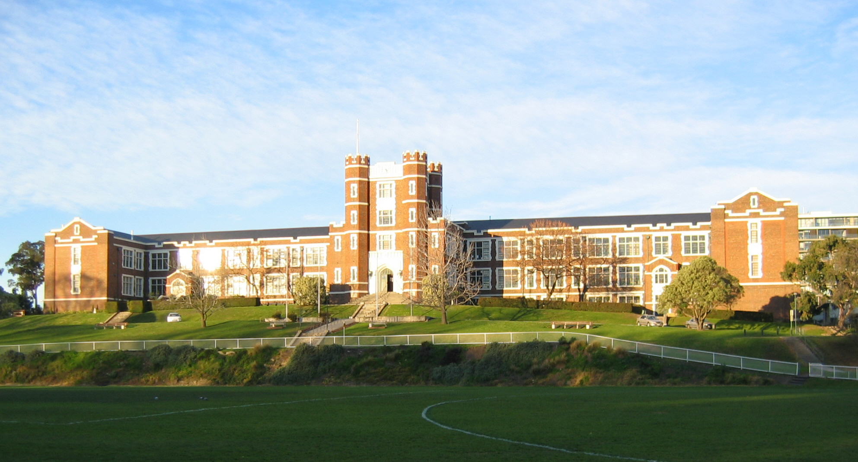
Melbourne Continuation School est. 1905

Slide 6
Sunshine Technical School est. 1912

Slide 7
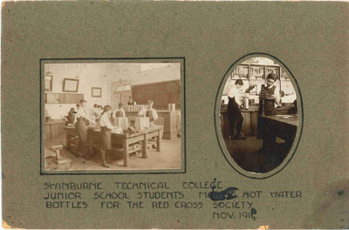
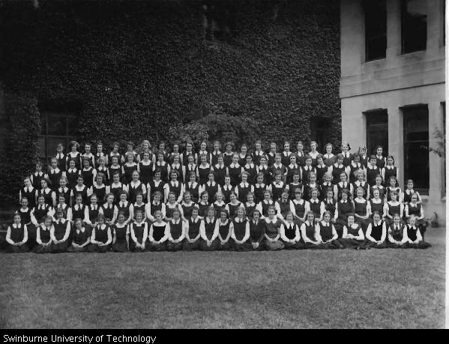
Swinburne Girls’ Junior Technical School

Slide 8
Ideological Enemies
Donald Clark – First Chief Inspector of Technical Schools
Separating “the professional and the industrial, the sheep and the goats” in the high schools
Martin Hansen – Inspector of Teachers and Schools, later Director of Education
“the suppression of class consciousness and of individual greed”

Slide 9
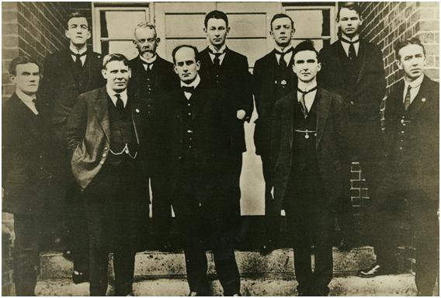
Democratic credentials?
Martin Hansen – saw the divided system as “anti-democratic”
Donald Clark – saw high schools as neglectful of the “social and economic circumstances” of working class children
Footscray High School staff, 1916

Slide 10
The Hansen and Clark themes
A divided curriculum can be socially selective (Hansen)
Vocational education and training has struggled to establish a role within mainstream secondary schooling (Clark)

Slide 11
Secondary schools – no home for VET?
We have observed a series of historical phenomena; let us see what ideas they may justify us in forming about what secondary education is…….
The preliminary and purely negative observation…… is that secondary education has never had an essentially vocational goal……
Émile Durkheim, 1904

Slide 12
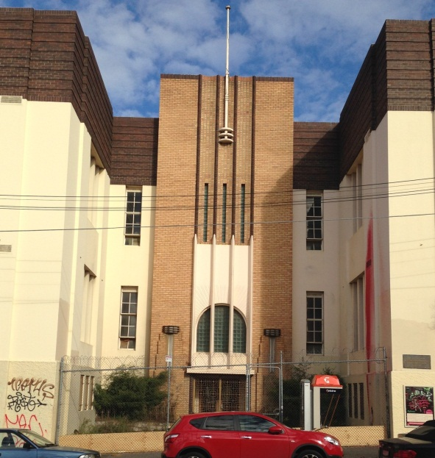
The Technical Schools – Victoria
1905 – FIRST STATE HIGH SCHOOL
1912 – FIRST TECHNICAL SCHOOL
1929 – UNIFICATION PROPOSAL DEFEATED
1986 – TECHNICAL SCHOOLS ABOLISHED
1994 – VET IN SCHOOLS INTRODUCED
2002 – VICTORIAN CERTIFICATE OF APPLIED LEARNING (VCAL)

Slide 13
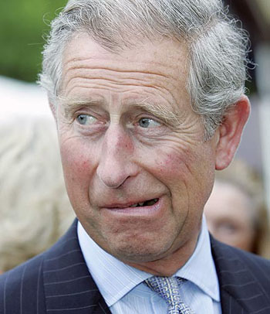
The Research Evidence
Low in status hierarchy (Goodson 1993)
No parity of esteem (Green 1995)
Has a weak knowledge base (Young 2007)
Merely a response to skills shortages (Jephcoate & Abbott 2005), co-opted to serve economic needs or absorb unemployed “men” and returned soldiers from the World Wars
Social selection (Ringer 2000, Baudelot & Establet 1971, Polesel 2008)

Slide 14
School completion and university

Slide 15
VET in Schools in 2014
Vocational subjects offered as part of senior certificate – Victorian Certificate of Education
Subjects count towards senior certificate
May count towards university entrance rank
Mainly delivered in schools, but also in adult VET providers, like Technical & Further Education Institutes

Slide 16
VET participation by sector

Slide 17
VET participation by SES

Slide 18
VET by sector and SES

Slide 19
Rainforest High School VET in Schools Participation By Father’s Education

Slide 20
Rainforest High School Views of Teachers
“The problem is if a teacher can teach maths and VET, maths gets priority. The issue is competition for staff”.
“It’s a struggle to put staff through Certificate IV training – this allows them to assess VET in any area. But then we are told that if the teacher becomes permanent, they won’t be allowed to teach VET. They will teach a ‘proper’ subject”.

Slide 21
Teachers and school culture
“Yes, the school culture supports VET, but staffing is the problem. The school is five teachers short. So, VET might miss out – academic teachers get priority…”

Slide 22
Innovative partnerships for VET in Schools – the impact of business partners
Dr Gosia Klatt
Lecturer, Education Policy & Leadership Unit

Slide 23
ARC Linkage Innovative partnerships for youth engagement in education and work, the University of Melbourne and Deakin University
Research objectives:
Limited research documenting what challenges are faced by partnerships between schools and external partners
Increasing number of school partnerships (e.g.more than 65,000 students in NSW involved in SWL)
Focus on understanding partnerships between schools and workplaces/external learning providers
Reporting on the findings from 1 Stage – school survey

Slide 24
The state and sector survey participation
Targeted all secondary schools (State, Catholic and Independent) in VIC, NSW and SA
Conducted online through Survey Monkey
Investigate teachers’ experiences and perceptions relating to approaches to applied learning pedagogies, the institutional support for and barriers to these pedagogies, and the nature of partnership experiences that these teachers have had and would prefer in delivering and managing these programs.
 | State | Catholic | Independent | Total
Victoria* | 55 | 25 | 10 | 90
New South Wales | 36 | 25 | 24 | 85
South Australia | 30 | 10 | N/A | 40
Total: | 121 | 60 | 34 | 215

Slide 25
Defining applied learning/VET
Learning for work and engagement at secondary school
VET in Schools (VETiS) – programs that involve the delivery of Australian Qualifications Framework (AQF) qualifications by Registered Training Organisations (RTOs).
Applied Learning - experiential, hands-on, active learning which provides practical, work-related experience, and other skills that are important for life and work
Flexible Learning – Flexible school and/or community based learning programs, which may include individual case management.

Slide 26
Thinking framework
Seddon, T., Billett, S., & Clemans, A. (2004)
Social partnerships are “significant policy trend” and are “driving particular styles of working and resourcing education”
New pressures on schools lead to “destabilisation and reconfiguration ” of traditional learning spaces
Wheelahan & Moody (2011)
Educational institutions are supply driven – offer what they think is important
RQ: What are the consequences of social partnerships in education settings – for schools, for partners, for students?

Slide 27
Types of partners
Q14) What types and number of 'partner organisations' support the provision of applied learning/VET/flexible learning options offered by your organisation?

Slide 28
involvement of businesses
Ten or more partnerships with businesses in rural and regional Victoria
Victoria | Ten or more | Up to 9 | None | Total
Metropolitan | 18.8% | 45.8% | 35.4% | 100%
Regional | 50% | 31.2% | 18.8% | 100%
Rural | 64.3% | 21.4% | 14.3% | 100%

Slide 29
Benefits to students
Q12.To what extent do students experience the following benefits from participation in your organisation's applied learning/VET/flexible learning options?
High degree of benefit:
83.80% employability skills
68.80% improved understanding of career pathways
66.00% increased engagement in learning
“Practical hands-on activities and real industry experiences facilitate student's learning and engagement as significance is key to the subject.”
“Student connections with community and industry greatly enhance their personal development and understanding of potential vocational pathways.“
“It is often the case that those students who have the worst behaved in Yrs 7 - 10 mature well when they participate in one day per week work placement with adult males in industry . This mentoring is vitally important.“

Slide 30
involvement of businesses
(Q15) What role does the partner play in your applied learning/VET/Flexible learning option?

Slide 31
challenges
“Over the years we have found it to be of much more value to our students to have direct contact with employers rather than with representative bodies.”
“a lot of arrangements are not formalised and vary in the degree of interaction”
“more input and support from employers (is) required”,

Slide 32
Role in initiating partnership
(Q20) To what extent have the following organisations/networks played a role in INITIATING your partnering arrangements?

Slide 33
challenges
“Because of our location and consequent distance students would have to travel to other providers. It has always worked best for our students where the training competencies are delivered on site with business partners providing opportunities for workplace learning….”
“is difficult in a regional setting”,
“we are in a small country town so we rely mainly on local businesses. Sometimes (it is) difficult to access some organisations”.

Slide 34
Concluding
Businesses have a crucial role to play within the range of partnerships which schools
Central role in providing access to workplace learning and work placements
Viewed positively by the respondents and are regarded as effective
Also a challenge for schools as coordinators
Rural and regional schools limited access
Dependent on individual businesses’ willingness and skills

Slide 35
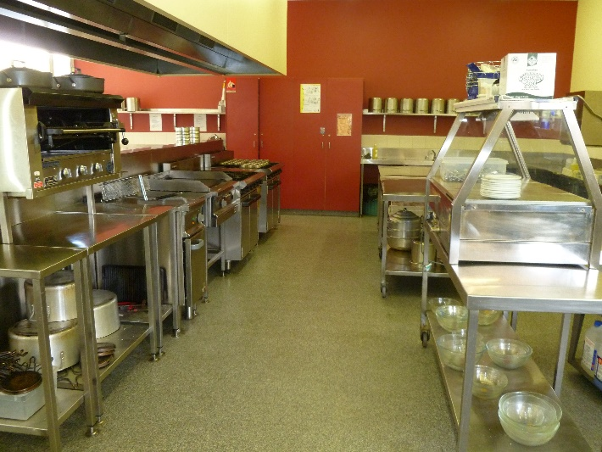
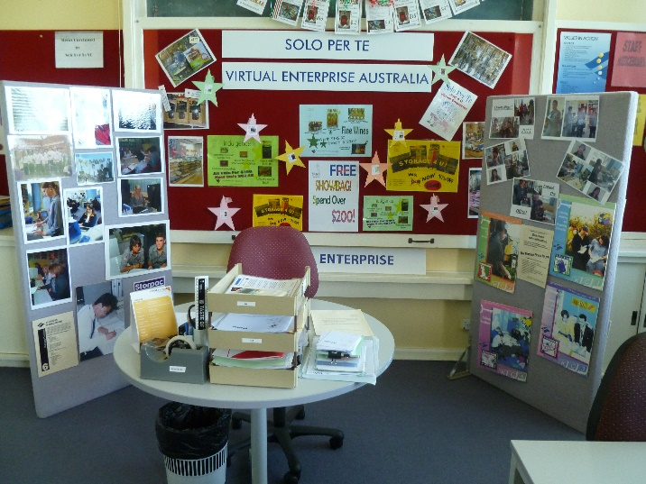
Preparing young people for occupations: current policy trends in VET in Schools
Kira Clarke
Lecturer
Education Policy &
Leadership Unit

Slide 36
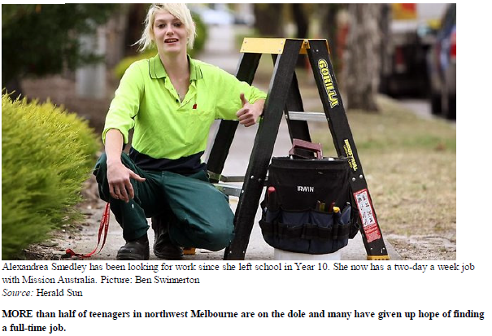

Slide 37
Role of VET for young people
Source: NCVER Vocstats 2014
Notes:
VETiS 127% increase
Early leavers 27% increase
School completers 13% increase
When talking about the efficacy of VET in Schools – we are talking about 220,000 young people.

Slide 38
Policy vision for VET in Schools
This was the national framework up until December 2014
“Vocational education in schools assists all young people to secure their own futures by enhancing their transition to a broad range of post-school options and pathways. It engages students in work related learning built on strategic partnerships between schools, business, industry and the wider community”
(MCEETYA 2000, p11).
Notes:
This program of VET in Schools research has been conducted within a policy context. While I have already made note of the diversity and variation of approaches to VET in Schools across Australia, it is pertinent to make note of the national policy vision for VET in Schools. VET in Schools is seen as a mechanism ideally strengthening outcomes for young people in a range of post-school activities. To what extent does this vision hold true?

Slide 39
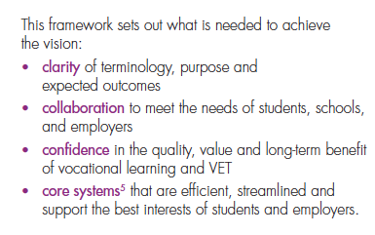
Notes:
Very clear policy objective
Assistant Minister Sussan Ley is reviewing this policy statement at the moment and looking to boost participation in SBATs.

Slide 40
Clarity
Issues of terminology and status:
“This framework moves away from terms such as vocational education and VET in Schools, replacing them with terms that clearly distinguish between two different areas: vocational learning and VET.”
“It creates shared understanding by clearly distinguishing between vocational learning and VET, and noting that the VET delivered to secondary students is the same as all other VET.”

Slide 41
Findings from three years of VET in Schools Research
Any revisions to the vocational curriculum needs to promote access for all students to the foundational disciplinary skills and knowledge needed to support their careers.
Consideration needs to be given to how the vocational curriculum can be used to greater effect in the junior and middle years of school to support and inform vocational pathway choices in the senior years.
This is currently complicated by the location of VET in Schools subjects within the senior secondary certificates.
Opportunities should be explored that look more broadly at the role of vocational education in secondary education, not just VET in the senior secondary years.

Slide 42
Collaboration
Pressure on schools to work in a space they may have historically little experience or expertise in working:
“Effective vocational learning and VET depend on collaboration. Central to this is bringing schools and employers together”

Slide 43
Findings from three years of VET in Schools Research
Any re-development of VET in Schools:
How to enable, within these entry-level qualifications, exploration of a broader range of related occupations within an industry;
How to integrate meaningful ‘learning about’ the industry, including understanding issues of mobility, growth and localised issues; and
How to create clear, coherent and transparent pathways from these foundational or ‘career start’ qualifications to intermediate and higher-level qualifications.

Slide 44
Confidence
The old ‘VET is VET is VET’ mantra:
“Such information can give students confidence that the VET they undertake while at school can provide direct entry to employment…”
“VET students can study VET courses alongside core curriculum”
“shared marketplace”

Slide 45
Qualifications for young people
The new framework has reinforced problematic reliance on predominantly foundational certificates to support entry to the labour market.
The vocational qualification with which a young person leaves school should form the foundation not only for their first job but for their on-going career in their preferred industry.
The new framework has also retained the use of narrowly defined occupations as the structural basis for vocational curriculum in secondary schools.

Slide 46
A problematic certificate paradigm
Role of qualifications for young people
Gallacher (2011) provides a three element purpose for qualifications:
entry to work
entry to higher level qualifications
widening access to tertiary education
How is VET in Schools holding up?

Slide 47
Efficacy of VET in Schools?
Current approaches to the provision of vocational curriculum enable:
Limited entry to work – ‘meaningful work’.
Limited entry to higher level qualifications.
“Ghettoising” of VET in Schools programs means it is also playing limited role in widening participation in tertiary education.

Slide 48
Core Systems
Greater system lead development and guidance:
“The first responsibility of core systems is to provide clear guidance to the different stakeholders involved in the delivery of vocational learning and VET to secondary students.”

Slide 49
Supporting choices
“There was a consensus that students need to be at the centre of vocational learning and VET, with decisions guided by their long-term interests. Meeting the needs and expectations of employers is also vital, as they make the ultimate assessment of quality when deciding whether to offer jobs to young people.”

Slide 50
What does the research evidence say?
Approaches to provision of vocational curriculum in secondary schools:
Contemporary education/training landscape means the agency of low SES young people (who dominant VET cohorts) is constrained and the currency of their educational attainment is limited in gaining access to programs/pathways/occupations of choice.
‘young people need occupational structures and well-established and reasonably secure routes into the labour market through vocational education’ (Winch & Clarke 2003, p.250)
‘existing systems fail to provide a coherent and effective pathway to sustainable occupational careers’ (Clarke 2012, p.7)
‘students self-select into school VET programs because they see these programs as providing a better match with their (self) perceived academic ability’ (Anlezark et al 2006, p.7).
Within the neo-liberal market context, learners are constructed as consumers (Wheelahan 2011).
This marketised training landscape reinforces problematic assumptions that learners choose their qualifications and providers based on an informed understanding.
Human capital theory argues that any knowledge or skill attainment strengthens labour market prospects (Shavit & Mueler 2000, Becker 1975, Rumberger & Daymount 1984)
However, the concentration of disadvantaged learners within vocational programs acts to reproduce inequality (Collins 1979, Iannelli 1997) and VET, as an education system, also contributes to cultural reproduction (Ainsworth & Roscigno 2005).

Slide 51
Findings from three years of VET in Schools Research
Useful principles for underpinning future reform
Qualifications completed during school must reflect employment and training opportunities in the labour market
A safety net is needed for students who enter directly into the labour market
Systems and schools must avoid the emergence of a system which tracks students on the basis of their social background
Workplace learning needs to support learning for and about, not just in work

Slide 52
Questions?

Slide 53
Thank You
Further reading
Polesel, J. (2010) “Vocational education and training (VET) and young people: The pathway of the poor?", Education + Training, Vol. 52 Iss: 5, pp.415 – 426
Klatt, M. and Polesel, J. (2013) “Vocational education and training in Australia and three-dimensional federalism”, Australian Journal of Education April 2013 vol. 57 no. 1 74-86
Clarke, K. (2014) Entry to vocations: building foundations for successful transitions, NCVER.
Clarke, K. and Volkoff, V. (2012) Entry to vocations: current policy trends, barriers and facilitators of quality in VET in Schools, NCVER

