Slide 1
GROWTH VS CONSOLIDATION
Dr Greg McMillan, Pro Vice Chancellor (TAFE) for
Nik Babovic
Deputy Vice Chancellor Industry, Vocational Training and Access Education

Slide 2
Background
CQUniversity – a comprehensive University
Division of Industry, Vocational Training and Access Education
Merger with CQTAFE
Growth vs Consolidation
CQUniversity – Strategic Intent

Slide 3
History
Mid-1990s
Colleges to Institutes
Contestable market – user choice
Late 90’s/early 20’s
Move away form the value of TAFE brand
2005-2006 period
6 metro TAFEs consolidated into 4
Skills Tech Australia was formed
Gold Coast and Southbank made Statutory Authorities

Slide 4
History cont…
Post 2006 some general work done to ‘standardised’ elements of Regional Queensland
Industry engagement
Business development
2014 plus
Two Models emerged
1 July 2014 Merge between CQUniversity and CQ TAFE (4 years in the planning)
TAFE Queensland a centralised statutory Authority

Slide 5
What is growth?
Growth in an organisation is when it expands in size……two types of growth:
Organic growth – expand products and sales
Acquisitions and Mergers

Slide 6
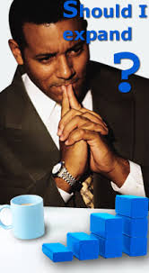
What is growth?
Business expansion
Profit from economies of scale
A larger market share
A means of survival to compete
with other growing businesses

Slide 7
Why consolidate?
A strategy to increase operational effectiveness
Consolidating services to cut overhead costs
Combine processes and business units into more streamline effective work units
Can your training organisation consolidate to prosperity?
The first phase of a project is to consolidate the outside walls, but what then……..

Slide 8
Why grow?
Because in business stuff happens!
Loose a contract
Funding changes
Changes in Government funding policy
Market changes etc…..
‘Stuff Happens’

Slide 9
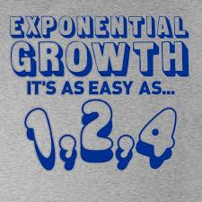
Why grow?
Well lets grow our way out of trouble! But How?
- Change strategy
- Hire sales staff
- Go for tenders
You need momentum

Slide 10
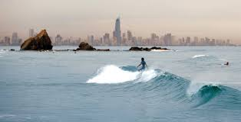
Growth for Sustainability
What causes TAFE/RTO success?
Strategic positioning
80% chance of success if you have the right strategic intent
One hundred or more strategic options
Rate of growth
Surf the right
waves!!

Slide 11
Strategic elements to success that you need to be able to answer in your business
Pricing mechanisms (revenue sources)?
Strategic alliances/partnerships (what kinds)?
What are you trying to do as a
training business?
What is your
business model?

Slide 12
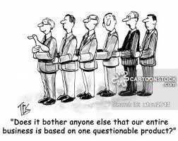
Strategic elements to success that you need to be able to answer in your business
How do go about business in the market everyday?
Do you make your decisions reversible and are you afraid to reverse your decision?
How do you become the dominant player in the market you work in?
Position yourself to succeed

Slide 13
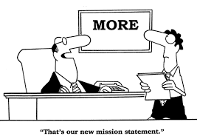
How can I position the organisation for success?
A mission statement is not enough, you need to break down what your training organisation will look like when it grows, where will the increase come from?
Organic growth
Tenders
International
New products
Where will you deliver
What services will you offer
What kinds of customers
You need total clarity
(Warning! This will mean constant change)

Slide 14
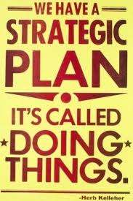
Our Strategic Intent
Profitable Growth
Student, Client Satisfaction and Retention
Staff Professional Development
Industry and Business Engagement
Research
Build a great Strategy
Build a great Team
Focus on Growth

Slide 15
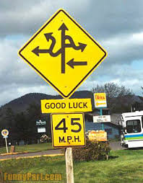
Last throw away lines I will leave you with! (My Learning's)
Build the formal strategy democratically this will allow you to implement autocratically
If you don’t have a great strategy everything else is inconsequential
Remember surf the right waves!
Thank you

