Slide 1
Academic Unification to Build a Comprehensive University
Kim Harrington
Associate Vice-Chancellor, Rockhampton Region,
and Director of Academic Unification

Slide 2
What is the first thing that comes into your head ? when I say
“banana”
Notes:
Business process – high level organisational requirement (endorsed by Deans)
Functional specification (People and Processes) – this described in detail the processes, interactions, responsibilities and timelines associated with the desired articulation system
Business requirement (System) – defined the business requirement in terms of what the technology solution has to deliver

Slide 3
Notes:
Request for Quotation
Selection
Contract
SharePoint
OBS

Slide 5
Imagine what the variations of thoughts on what Academic Unification means to individuals within the one organisation and then perhaps we need to double the variation when you bring 2 organisations together; and then what does this all mean to industry, the community and students.

Slide 6
Is it this ?
or
Is it this ?
Notes:
Workflow based system for managing the processes and tasks associated with an application for an articulation agreement from initial Expression of Interest (EOI) through to development of a formalised agreement
System also incorporates a comprehensive review process based on:
Annual, triennial and special review requirements
Includes 5 stages:
Expression of Interest
Full Application
Review, assessment and recommendation
Approval
Review of agreements

Slide 7
Is it Study Pathways ?
VET in Schools’ Courses (Certificates)
TAFE Courses (Certificate III)
TAFE Courses (Certificate IV and or Diploma)
CQUniversity Programs (Undergraduate degree)
CQUniversity Programs (Postgraduate degree)

Slide 8
Is it a redesign of higher education?
Third year – Degree
Second year is Associate Degree or Advanced Diploma
First year is Diploma

Slide 9
Is it ?
Multiple entry points
Multiple exit points
Access to interim awards
Bi-directional
Value add skills sets

Slide 10
Is it ?
Pathways
Articulation
Advanced standing
Credit points
Direct entry

Slide 11
Is it ?
The TAFE courses taught by TAFE staff
The TAFE staff teaching perhaps the 1st year of a Degree
The university academics perhaps teaching the TAFE Diploma

Slide 12
Is it ?
2 different training and education sectors becoming one
A place for lifelong learning
A one-stop-shop
Making graduates more employable

Slide 13
Is it ?
2 different academic legislative quality standards
2 academic systems becoming one
2 different cultures coming together

Slide 14
We Discovered it was all of this plus more

Slide 15
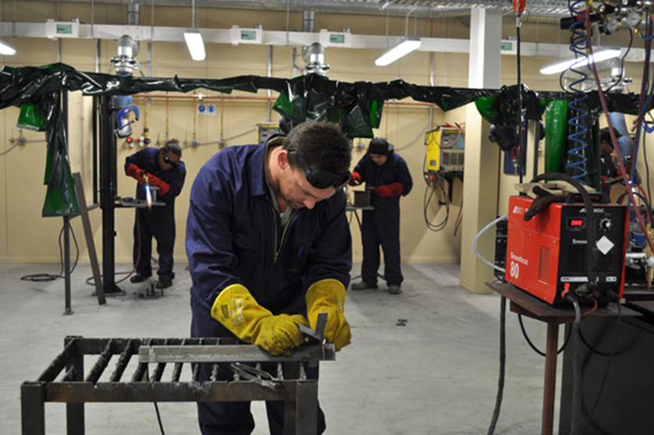
How are we making it happen? So THIS

Slide 16
Can BECOME THIS

Slide 17
BY WORKING WITH A GREAT NUMBER OF PEOPLE & SECTIONS
CQ TAFE
Train@
Learning & Teaching
Higher Education Schools
Vocational Teams
IT Department
Office of Indigenous Engagement
International Directorate
Marketing Directorate
Student Experience
Corporate Governance & Quality
Vocational & Industry Research Leaders
External Stakeholders
Executive
External Consultants
Academic Board
University Council

Slide 18
The academic unification project enhancements focused on accessibility, innovative curriculum & program redesign, entry & exit points, clearly defined bi-directional pathways and academic corporate governance, whilst working alongside ITD to develop new IT systems.

Slide 19
The project was primarily made up of fifteen critical components, which will assist in creating and supporting a comprehensive university, these are:

Slide 20
New Curriculum Models
New Curriculum Strategies
Comprehensive Precincts
Best Practice Research - Dual Sector Academic Governance
Articulation Business Process and IT automated workflow system
Moodle for TAFE and Migration of CQUniversity Moodle to version 2.7
Market Research
New Products to bridge the gap
Analysis and Review of CQUniversity and CQ TAFE academic/curriculum governance structure & quality system and the design of a new academic governance framework
ITD Systems
Design & development new Preparatory Programs, Health, Engineering & Foundation for International
Creation of Capability Statements
Review or RPL Business Process & development of resources
Procurement & implementation of a placement (WIL) system
Marketing

Slide 21
New Curriculum Models
• Interim Award – First year of a degree has the option of a Diploma as interim award. • Pathway – Diploma is delivered by TAFE@CQUni and or Train@ and the degree is a 2 year program. • Credit – Straight articulation – vocational qualification at TAFE@CQUni, Train@ or other RTO with credit equal to one year. • Diploma with Distinction – additional learning or assessed work placement. • Internships • Dual Offerings/Combined Awards

Slide 22
New Curriculum Strategies
• Course/program non-completion auto check for eligibility of a lower level qualification • Parallel – Parallel certificate IV or diploma as student is studying for a degree. • Skill Set – Vocational units as additional study. • Value Add – Fee for service and non-accredited. • Enhanced delivery methods – revitalisation of existing vocational delivery modes • Pathway from Certificate III to degree
• Preparatory Programs

Slide 23
The PROJECT LEGACY
It is critical that dual sector programs and dual sector curriculum models become a ‘way of life’ for the comprehensive university. Consequently establishing quality assurance and corporate governance practices which embed dual sector curriculum and therefore ensure processes become systemic in the design, development and review of courses and programs currently and into the future, for the purpose of offering fluid bi-directional training and educational pathways for students studying across the range of AQF levels. The Academic Unification Project focused on all aspects of quality, governance and process re-engineering in relation to curriculum.

Slide 24
It is a journey, a transition, bedding down systems, process, governance and cultures while we establish the comprehensive university.

