Slide 1
Industry led workforce planning and training delivery in an emerging sector Dr Ros Cameron Research Fellow, Curtin Business School, Curtin University
AVETRA Conference, 8-10th April 2015, Melbourne
Co Authors:
Anthea Middleton
Wayne Delaforce
Nathan St John
Energy Skills Queensland (ESQ)
ESQ logo HERE

Slide 2
INTRODUCTION
Research Fellowship at Curtin Business School – 4 Years
Human capital needs Australian gas (LNG) industry
CQUniversity Gladstone, QLD
World first: 3 x CSG/LNG Plants being constructed Curtis Island
20 yr export contracts with China
Independent Chair, Regional Community Consultative Committee- 3 Gas proponents and community
Energy Skills Queensland (ESQ) State Industry Skills Body
Co Authors:
Anthea Middleton
Wayne Delaforce
Nathan St John
Energy Skills Queensland (ESQ)

Slide 3
Overview
OVERVIEW
With the introduction of new industries and technologies, industry is often forced to take a lead role in training design and delivery. This paper will use the emergence of the Coal Seam Gas (CSG) to Liquefied Natural Gas (LNG) industry in Queensland over the last decade as an example of this process, where a number of divergent multi-national projects and constituent companies have been required to actively participate, coordinate, and fund the evolving training model for the new industry.

Slide 4
CSG to LNG
CSG to LNG
Context of the CSG to LNG industry and explore the key reasons why industry became an active participant in the development, design and delivery of training(drivers).
We examine the formation of a sector based taskforce to determine the skills and workforce requirements specific to this growth industry, and the central role played by collaborative skills forecasting and workforce planning.

Slide 5
VET response to greenfield projects
GREENFIELD PROJECTS
The purpose of the paper is to review how the VET sector can better respond to major “greenfield” projects, where there is no existing training market.
A series of reflections which capture and distil key lessons learnt are presented to inform academics, practitioners and industry working in “greenfield” areas

Slide 6
INTRODUCTION- Energy Sector
The future prosperity and productivity of many economies relies heavily on the energy sector being able to adequately plan for and access a skilled workforce. The energy sector will offer future employment into the next decade for thousands of skilled workers, however the training system needs to anticipate and forecast the future skills and industry requirements to combat the lag time between future demand and supply.
Aim: Explore the role of industry skills bodies in forecasting current and future skills needs to ensure that education and training systems are suitably adapted and to avoid skills gaps, shortages and mismatches.
Case Study: to illustrate the central role played by industry skills bodies in brokering such activities between key industry stakeholders.

Slide 7
AUSTRALIAN LNG INDUSTRY

Slide 8
Case Study: Energy Skills Queensland (ESQ)
The case study is based on ESQ, the industry skills body for the Queensland energy industry.
ESQ established in 2008 - plays a crucial role in state government engagement on issues relating to education and training, skills development and labour market for the energy industry.
Key activity: industry-based workforce planning research.
Established partnerships with industry and a range of stakeholders:
industry peak bodies
education and training providers
regulators
government
unions
corporate groups

Slide 9
Case Study: Energy Skills Queensland (ESQ)
The energy industry covers the following high growth sectors:
Electrotechnology
Telecommunications
Electricity Supply and Rail
Electricity Generation
Sustainable and Renewable Energy
Gas Transmission and Distribution
Coal Seam Gas to Liquefied Natural Gas (CSG/LNG)
Mining

Slide 10
Industry Engagement- Leadership Groups
The following leadership groups have been established:
Drilling Industry Leaders Group
Drilling Industry Training Group
Electrotechnology Industry Leaders Group
Electrotechnology Training Committee
ESI Industry Leaders Group
Telecommunications Industry Leaders Group
Telecommunications Training Committee
Mining Industry Leaders Group

Slide 11
Australian Industry Skills Councils- Administered by DEEWR
11 National Industry Skills Councils:
SkillsDMC:
Drilling, Mining, Quarrying Civil infrastructure
E-Oz Energy Skills Australia: electricity generation, supply, electrotechnology, gas supply
State Bodies
Queensland
ESQ
Construction Skills

Slide 12
CASE STUDY: 3 X CSG/LNG PLANTS
Focus of the Case Study: workforce and skills planning undertaken for the world’s first projects to convert Coal Seam Gas to Liquefied Natural Gas (CSG/LNG).
This represents the largest combined construction sites the first tier contractor Bechtel, has ever undertaken and involves three CSG/LNG plants in regional Queensland Australia.
Construction stage: on these plants began in 2009 and are due for completion in late 2014 early 2015.
Operational stage

Slide 13
CSG/LNG PLANTS – CURTIS ISLAND
The projects are:
Queensland Curtis LNG (QCLNG)
Santos GLNG (GLNG)
Australia Pacific LNG (APLNG).
ESQ has played a crucial role in assisting the Queensland government and the CSG/LNG industry in planning for the skills and labour force required for this mega project which required the recruitment of over 25,000 workers at different stages of the construction.

Slide 14
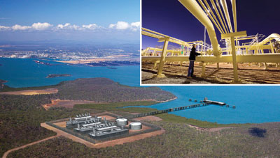
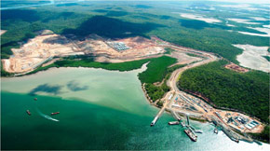
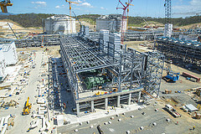
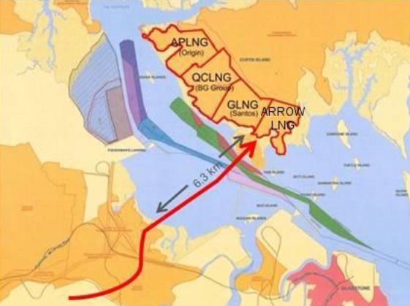
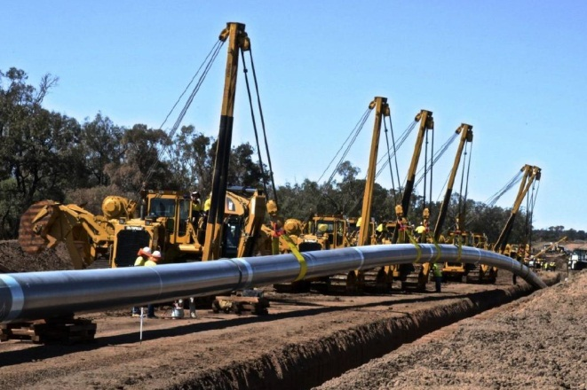
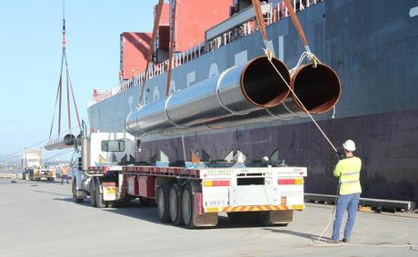
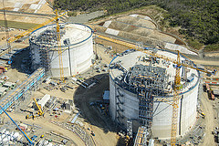
GLADSTONE CSG/LNG PROJECTS

Slide 15
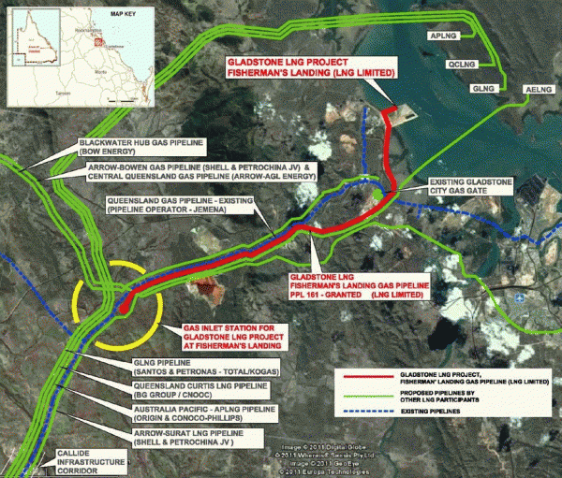

Slide 16
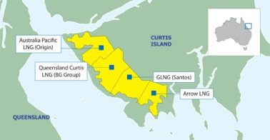
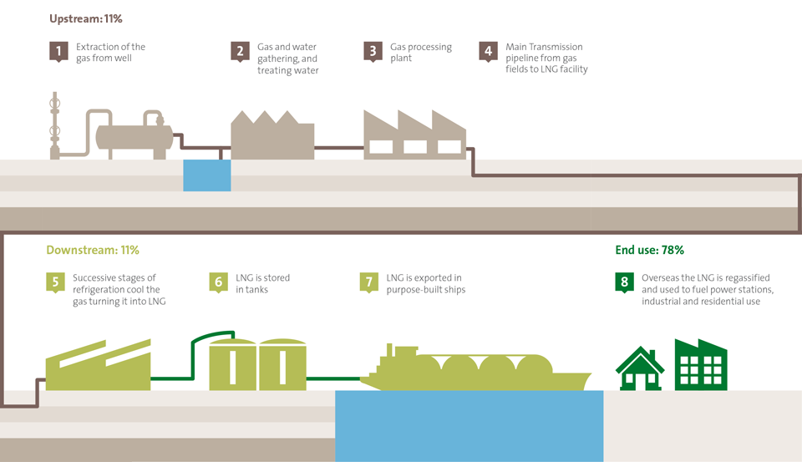
CSG/LNG Queensland
PROJECT | DETAILS | Location
Australia Pacific LNG (APLNG) | JV: Origin and ConocoPhillips. | Curtis Island, Gladstone, QLD
Gladstone Liquefied Natural Gas Project (GLNG) | Santos and PETRONAS’ | Curtis Island, Gladstone, QLD
Queensland Curtis LNG | QGC – A BG Group business | Curtis Island, Gladstone, QLD

Slide 17
Workforce Planning
While there are some cross over skill sets needed across these two major phases each stage required different capabilities and workforce sizes.
Added dimension of complexity - broad geographical reach of the CSG/LNG industry not only in terms of extraction and production (spans from CSG wells located in the Surat basin to transportation across 200’s of kilometres to port on Curtis Island in Gladstone) to operations in the metropolitan centre of Brisbane.

Slide 18
CSG/LNG Skills Taskforce
2009 the CSG/LNG Skills Taskforce was formed in collaboration with the then Department Education and Training and contracted ESQ to undertake the workforce planning for the CSG to LNG industry in QLD.
The CSG/LNG Skills Taskforce - representatives from all five major CSG/LNG companies operating in QLD along with state government.

Slide 19
2009 Construction Workforce Plan
As a precursor to the 2013, 20 year operations and maintenance workforce plan being discussed in this paper, ESQ was contracted by Construction Skills QLD (CSQ) to undertake the development of a CSG/LNG Construction Workforce Plan.
ESQ worked closely with the first tier contractor (Bechtel) to develop the construction workforce forecast of aggregated workforce data and its analysis. This resulted in the development of the 2009 Construction Workforce Plan.

Slide 20
CSG/LNG Workforce Planning
2009 - 6 priority areas:
labour shortage
skills shortage
lack of competent workforce
inadequacies in capacity and capability of training providers
misalignment of competency based training packages to meet industry requirements
replacement demand

Slide 21
CSG/LNG Workforce Planning
ESQ produced workforce planning research in 2009 and supplemented and expanded with further research undertaken in 2013. To undertake this:
Each company provided workforce data and information regarding their projected workforce needs. This data was aggregated into an industry skills demand forecast. Energy Skills Queensland then reviewed the Queensland labour market to gain an understanding of the supply of skills in order to forecast the skill gaps. The mismatch between skills demand and supply provided the industry with a list of critical occupational grouping which has enabled the industry to focus its attention and resources on strategies to meet identified skill shortages (ESQ 2013, p.1)

Slide 22
Drivers
As part of this process ESQ identified the following drivers of industry skills demand for these projects as follows:
New technological processes for converting CSG into LNG
A zero based start scenario amounting to a, ‘Greenfields’ industry which represented a world first. In other words a workforce yet to exist
Export contracts were signed to deliver LNG prior to any workforce being allocated to build and operate the LNG plants. This amounted to workforce planning being an afterthought during these early stages resulting in high skills and workforce shortages which led to increased salary pressures and reliance on overseas workers.
Cont….

Slide 23
Drivers….
The agility and ability of the registered training organisations (RTO) industry sector to respond infrastructure, the training workforce capability, the training provider capacity and their ability to respond to a new market demand was limited
Traditional vocational education and training (VET) pathways did not cater for the skill sets required by this greenfield industry resulting in slow responses to demand
As part of this overall limited capability and capacity within the VET sector there was also a slow response to training package amendments and new qualifications being developed to address the skill sets required of this industry.
It was within this context that the CSG/LNG Skills taskforce was formed.

Slide 24
Workforce Planning methodologies
Operations and maintenance workforce plan produced in 2009 by ESQ (2009) utilised workforce numbers provided by the proponents. At that time the underpinning industry knowledge of the HR professionals was commensurate with the infancy of the industry in QLD and Australia. Over the following 4 years the growth in context and industry familiarity ensured that the workforce planning process documented for 2014-2034 reflected the much deeper understanding of the complexities of this emergent industry.

Slide 25
Workforce Planning
Due to this increase in depth of industry knowledge over this period the methodology employed to deliver the 2014-2034 workforce plan was more sophisticated than that which was employed in 2009.
2009 workforce plan was based on a number of qualitative techniques using desktop research, scenario development based on the economic growth, and stakeholder interviews to determine critical job roles

Slide 26
2013-2034 Workforce Plan
The 2013 workforce planning used
Proponents shared information with ESQ individually (e.g., expected number of wells, downstream operations workforce by train over time, number of workers per train which will decrease as workers become more competent, procedures become more streamlined, maintenance workforce projected closures)
Information was then assimilated into initial predictions and drivers of workforce growth, then sense checked with the four proponents (i.e., the Taskforce) and moderated and revised where necessary
Projections were re-calculated based on the above and any additional information provided as a result (was a cyclical process)
From these projections the downstream and upstream scenarios where generated
Identification of the critical job roles for both the upstream and downstream workforces were then generated

Slide 27
CSG to LNG project areas
The CSG to LNG industry requires a broad range of skills and occupations, across a vast regional landscape. Because of this, the research was divided into two key project areas of operations and maintenance:
1. Upstream: CSG field facilities including drilling, plant and pipeline components of the project.
2. Downstream: LNG processing facilities.
Upstream and downstream operations are geographically different with upstream roles being predominantly based in the Surat and Bowen Basins with some roles in Brisbane. The downstream workforce is located in Gladstone and Brisbane. Approximately 85% of the overall operations workforce will be required in the Surat Basin and surrounding areas, with approximately 10% and 5% required in Gladstone and Brisbane respectively

Slide 28
Upstream Downstream
CSG to LNG process starts at the well (upstream) where a mixture of gas and water is extracted and separated.
Gas is then compressed (compressed natural gas) and is transported by pipeline to the LNG train (downstream) in Gladstone. At the LNG train, the compressed gas is cooled in stages to form LNG, which is then pumped into specially designed vessels for transport overseas
‘upstream’ activity is regionally located in Surat and Bowen Basin and surrounding areas
‘downstream’ activity - Curtis Island in Gladstone with some centralised operations in Brisbane.
The workforce planning activities need to be closely aligned to these dimensions as well as to the phase in which the projects were at (Construction/production).

Slide 29
Operational Stage
Dec 2014 first shipment of LNG for export from the CSG/LNG proponents plants on Curtis Island have become operational (QCLNG).
GLNG and APLNG are due to commence exports by the end of 2015.
Signals the beginning of operational stage of the CSG/LNG production and marks the end of 4 year construction stage which spanned 2010 to 2014.
ESQ played a crucial role over both these stages in terms of initiating an industry and government collaborative effort to ensure the workforce requirements for both stages were being strategically addressed through sound and rigorous workforce planning methodologies and development initiatives

Slide 30
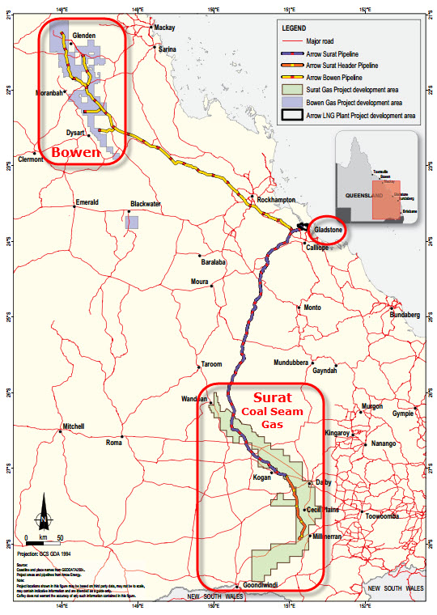
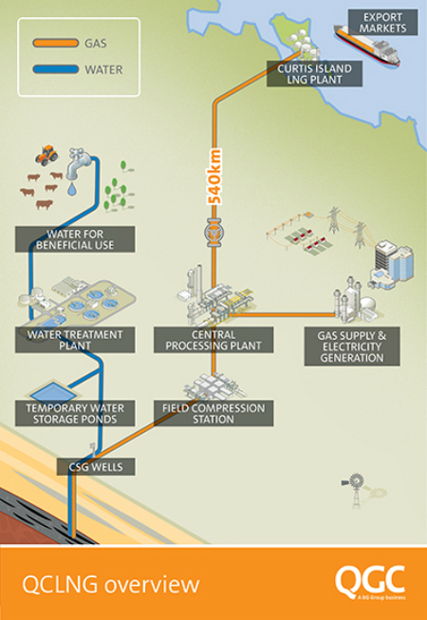

Slide 31
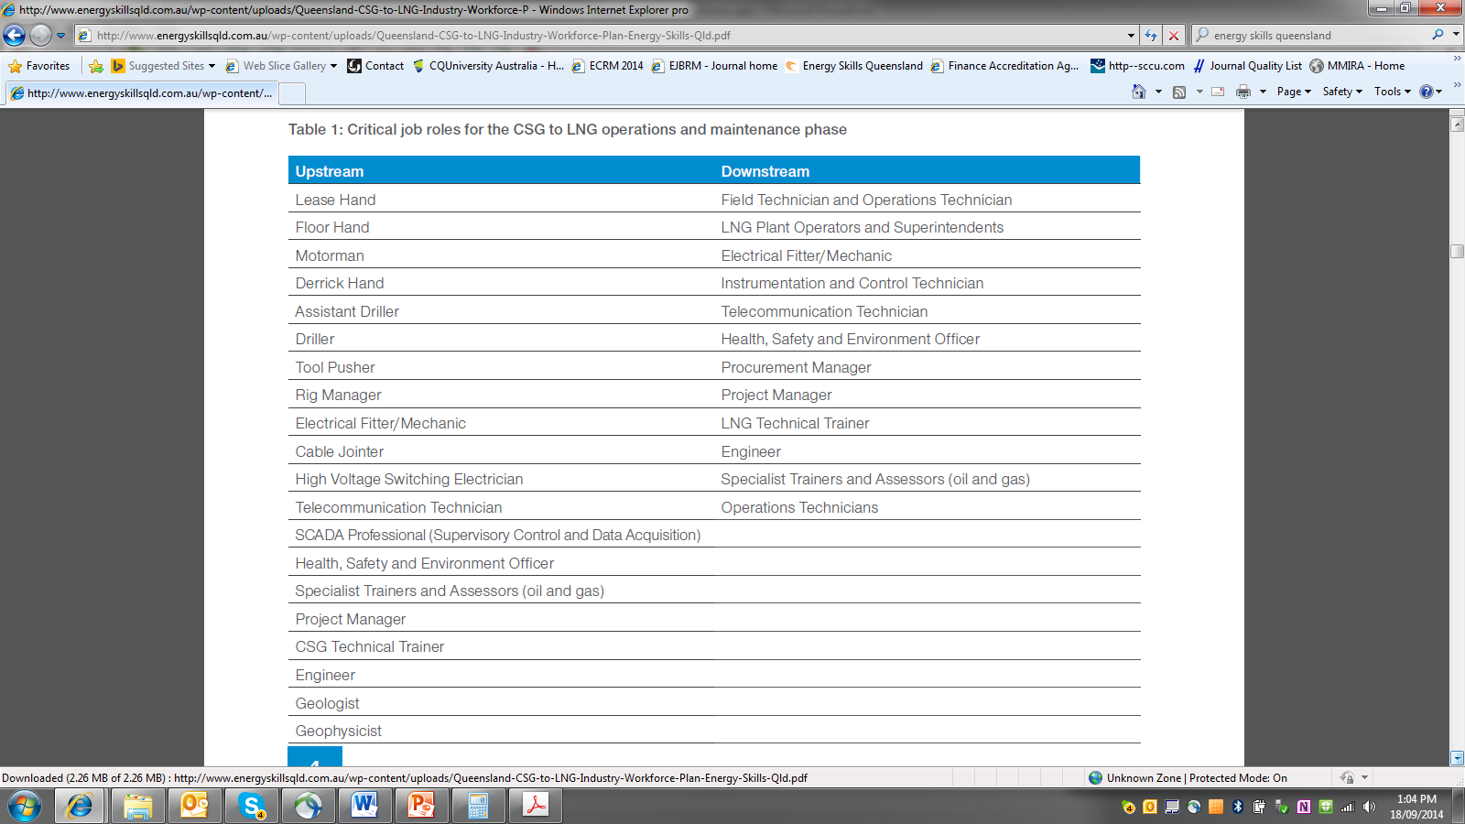

Slide 32
Qualifications in demand CSG/LNG projects in Gladstone
Engineering & Science EngDegrees -Civil, Chemical, Mechanical, Electrical & Petroleum Environmental Science | Mechanical Trade (Fitting) Dip in Engineering Cert III –Engineering, Mechanical (Maintenance, Diesel Fitting) + Vendor training
Trade (Technical) Drilling Drilling Oil and Gas Onshore (Cert II Dip) Process Plant Operators Cert III –IV Process Plant Technology + Skill Sets Electrotechnology Cert III –Electrotechnology Maintenance (Systems & Instrumentation) Cert III –Hazardous Areas (Electrician) | Field Construction Dip in Mechanical or Electrical/Engineering Trades (Non Technical) Cert IV –OH&S Cert III –IV Transport and Logistics Logistics Operations Warehousing and Storage

Slide 33
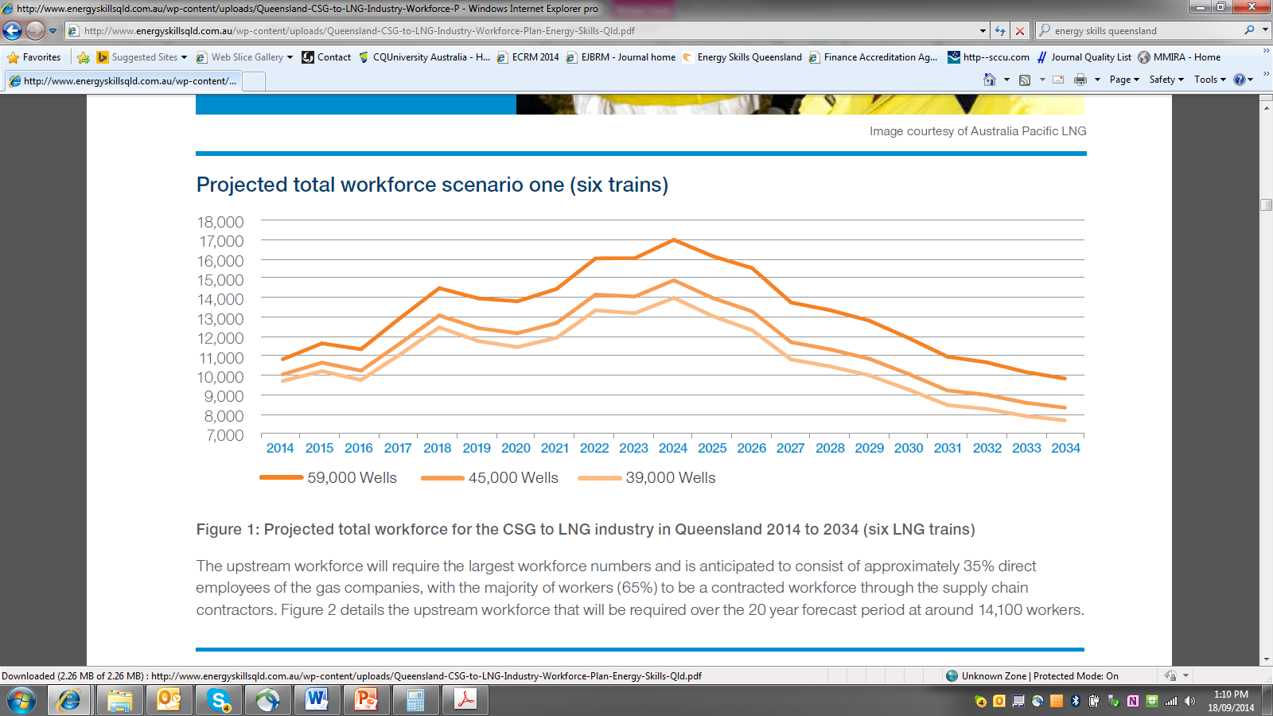

Slide 34
CSG/LNG Workforce Planning
2013:
Identified new technologies within the industry which have changed and have impacted the skill mix required from the workforce.
The contracted workforce is significant and required greater understanding especially in the upstream activities such as drilling, well servicing, and gas field development.

Slide 35
Workforce Planning for Sustainability
Key challenges next 3 years:
Greatest demand for skilled labour will occur as a result of Industry Workforce Turnover – due to ‘ageing demographic’ and high levels of ‘Occupational Detachment’ in trade and technical occupational roles.
Demand for new skills to enable two emerging growth sectors of significance to the Queensland Energy Industry:- ‘Sustainable Energy’ and ‘CSG/LNG’ sectors
Maintaining growth and sustainability with projected future skills shortages. Labour supply will contract as fewer people enter the workforce and the outflow of experienced skilled workers heightens in western economies.
Economic slowdown and falling business confidence, the intake of apprentices and apprentice completions are in decline in the short term. This will result in a worsening of skills shortages in the future, not only in the trades but in other occupations where the primary feeder stream for skills is trade apprentices.
The skills ‘experience’ void created by large numbers of Baby Boomers retiring will likely result in significant loss of knowledge and increased re-work unless priority is given to the retention of organisational memory.
Improved retention of apprentices and training outcomes to ensure relevance to future industry skilling needs.

Slide 36
Lessons
Limited industry collaboration in the early phases of the project driven by tight competition and a recognition of the need to develop a workforce from scratch meant that proponents responded internally each utilising a different strategy to develop their workforces.
Eg., one proponent brought in OS expertise from a Canadian training provider and tailored their existing knowledge of the gas industry internationally to operate within Australian training guidelines. This involved renting training facilities for an existing RTO in Australia which issued the qualifications, using Canadian staff.

Slide 37
Lessons
Limited industry collaboration
Another proponent leveraged their existing international operations to send workers in key roles to upskill them in LNG operations. This entailed some theoretical training in Australia and additional theoretical and on job training at overseas LNG facilities (Eygpt, Africa, Malaysia).
The third proponent sent key workers to Darwin and Perth for specialised training

Slide 38
Lessons
Reflection:
Each proponent chose different training methods because a) they didn’t have time up front to reach concensus
b) There was so much poaching happening that they wanted to ring fence their workers to protect their investment
c) they didn’t have deep relationships that allowed a level of trust that allowed for a conducive collaborative environment
As a result the opportunity to reduce costs (training) was missed. Co investment in training reduces overall costs.

Slide 39
Lessons
High Levels of Poaching
Initially high poaching of key staff across the four companies (2009 – 2011) led to distrust among the proponents to collaborate
Reflection:
Collaboration started in 2009 but didn’t see great fruition until 2014 with the exploration of the development of the Gladstone Energy Training Centre

Slide 40
Lessons
Reflections
They were able to collaborate over technical issues such as Training Packages and Apprenticeship and Trainneeships status
A number of divergent multi-national projects and constituent companies have been required to actively participate, coordinate, and fund the evolving training model for the new industry

Slide 41
CONCLUSION
The case study exemplifies how industry can work together to create a shared understanding of their projects’ combined future workforce skilling needs.
Exemplar: Skills sector forecasting (specific CSG/LNG)
Paper 2:
Mapping VET capacity across Australia to meet LNG Industry skill needs

Slide 42
Bahn & Cameron (2012) Conceptual framework - External forces
Global Commodity & Supply chains
Resources Boom
Employment Relations
Unions
Industry Associations
Employer groups
Characteristics of Resources Sector:
Minerals
Energy
Skills training
Migration policy

Slide 43
Bahn & Cameron (2012)
Global mobility:
Global labour markets
Global workforces
Global careers
Skilled migration: 457s & EMAs
National mobility:
Two speed economy
DIDOs, FIFOs & NRWs
Skilled migration
Skills shortages:
Demand and Supply
Impact on regions:
Sustainability
Attraction & retention
Pressure on infrastructure
Social responsibility
Training:
Technological innovation-Job design
VET/HE pathways
New jobs
Re-skilling & RPL
Workforce diversity:
Safety & wellbeing
Fatigue, drug & alcohol testing
Managing Diversity: Age, gender, culture
Equity groups

Slide 44
Anderson & Warhurst (2012) Skills ecosystems
A skills ecosystem is:
‘a dynamic network of interdependent institutions and actors which through their various interactions, roles, interests, needs and resources is in a constant process of change – evolving in ways that cannot always be predicted – but which shape the development, supply, demand and deployment of skills in any given industry or region.’

Slide 45
Anderson & Warhurst (2012) Skills ecosystems
Argue that by placing skill development, supply, demand and deployment centre stage, we can begin to overcome a policy preference for boosting skill supply through the formal institutions of education and training. This framework pose clear and important policy questions:
What is happening with skill supply, skill demand, skill development and skill deployment and how are changes in one area affecting others?
Who are the main actors and institutions in each of these skill areas and how are they shaping what is happening?
In what ways does this whole skill ecosystem seem to be evolving?

Slide 46
Anderson (2009) Middle Skills

Slide 47
Future Directions
Colleagues at Strathclyde University - Glasgow:
International comparison between Industry Skills Councils- role in skills sector forecasting:
Australia
UK
Germany
Robert Gordon University - Aberdeen:
Future skilling Oil & Gas industry – comparative North Sea and north western Australia LNG/FLNG

Slide 48
Dr Roslyn Cameron Research Fellow Curtin Business School
ros.cameron@curtin.edu.au

