Slide 1
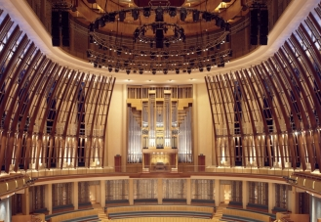
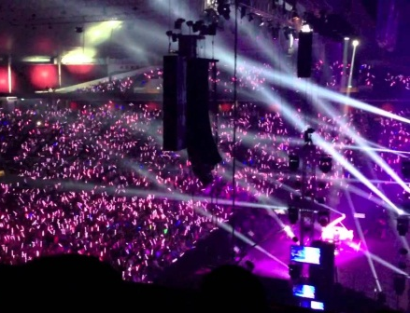
Learning & Development for Freelancers in Singapore’s Creative Industries: the Problem of Two Markets
Sahara Sadik, Dr Helen Bound Institute for Adult Learning, Singapore
Avetra, 9 April 2015

Slide 2
Singapore’s Creative Industries
Recent government commitment to the creative industries as part of push towards knowledge-based economy
Local with heavy int’l involvement
No law that local creative industries are protected
Commensurately small
3% of GDP, but target to double by 2020
Freelancers account for about 33% of total workforce
Anecdotally, 70% are freelancers in Film & TV

Slide 3
Making markets meet to better cater to L&D needs of freelancers
UNIQUE Freelancers in Singapore’s creative industries have particular L&D needs because of their “way of being”
VET MARKET Programmes are shaped considerably by VET policy imperatives that may not necessarily address the L&D needs of freelancers
EMPLOYERS IN CREATIVE INDUSTRIES Little ownership of L&D for freelancers; self-serving
FREELANCERS Poorly-organised to influence the VET agenda

Slide 4
Research Project
Research Questions
How does the experience of non-permanent work contribute to or constrain the learning of workers?
How do non-permanent workers identify with their work and how does this influence learning opportunities?
How can the learning of non-permanent workers be supported and enhanced?
Technical Theatre (n=23)
Adult Education
(n=30)
Creative industries
Transmutable workers in Singapore
Film & TV (n=18)
Low-wage (n=30)

Slide 5
Methodology
41 semi-structured interviews with freelancers in Film & TV, and Technical Theatre sectors
Purposive sampling to cover a range of job roles & years in the industry
12 in-depth interviews with employers, VET providers
2 reference group sessions with 39 industry stakeholders, including policy-makers

Slide 6
“Ways of Being”
Entrepreneurial self
craft
business
Learning at & through work
“Internal compass”

Slide 7
The Entrepreneurial Self
Technical
FIRST With their craft
Film & TV freelancers
identify:
Creative aesthetic
SECOND
As a ‘Freelancer’
Net-working
Entre-preneurial
Business skills
Mallea-bility

Slide 8
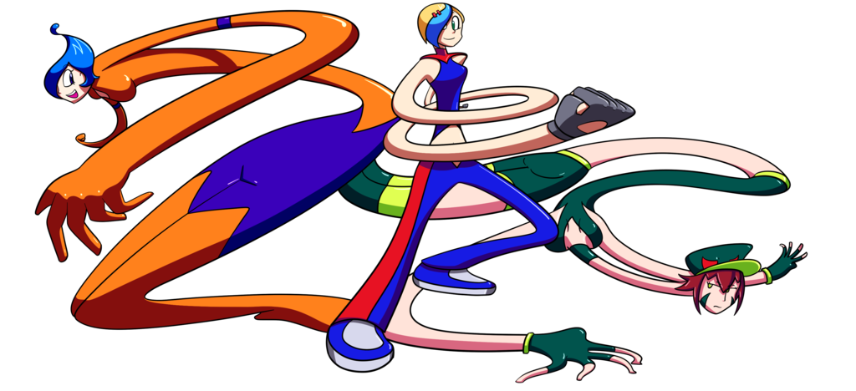
Constant Re-contextualisation
Knowledgeable practice
Technical & aesthetic
reflexive
meta-competencies
malleable
rapid reading of environments
knowing rules of engagement
reproduction of economic self
Notes:
Nature of freelance work leads to a particular kind of identity, where these workers are constantly reproducing themselves as an economic resource
First and foremost identify with their craft – camera, sound etc., then identify as a freelancer.
Here listed some of major skills required to operate effectively as a freelancer, that is to move from one project to another, illustrating the relationship between the technical, aesthetic and more generic skills and knowledge

Slide 9
Once you get a foot in and someone well-established says this guy can work, people will say good, come and work on my show, and it is very much that way.
- Ron, a leading lighting designer in Asia
The more you work in different environments, the more you come to an understanding that you have to change to fit yourself into different environments. It took me years to develop this “state of mind”.
- Howard, freelance video editor
I don’t want to freelance anymore because it’s very unstable and I was getting lesser and lesser (sic) calls (from Esplanade)…I started out with passion, but slowly the passion became money and money became a job…my passion kind of died.
- Ashley, lighting operator

Slide 10
Work is Learning
Self-directed learning
Observing & reflexive learning
When I edited my first drama, I know nothing at all. And you have to command people because you are the director. That’s tough, that’s …I studied the structure of the television programs. I walked around with a tape recorder. I have no concept of lighting or anything, I just shot it the best way I know how.
– Kevin, freelance director
The whole industry is about looking at what other people are doing. When I talk to my cameraman, I give them specific example of a movie that I watched that I would love. I said, have you seen that style? Something along that. That’s how we communicate.
– Victor, freelance producer

Slide 11
Informal Mentoring
He doesn’t just tell you how to read, he tells you the nuance of it. He tells you all the little things that is not in the books through his experience and through his knowledge.
- Nasser, freelance keygrip
I had an intuition for storytelling, but I was not surviving in the industry because I was not shooting fast and economical enough. He taught me how to shoot things in a factory way.
- Kevin, freelance director
Fariz started taking me as an assistant so that is where I feel I am going the right way.
- Yati, lighting operator
►
sense of professional isolation
►
stretch opportunities

Slide 12
“Internal Compass”
If you started working in a freelance world and you don’t have a direction, [that is a challenge]…Someone wants to be focused in certain skill for example - console, just want to be a console specialist to know, to operate, different kinds of consoles, to know the console inside out, become a specialist in that area. He won’t simply take up a sound job or a cable job or other jobs. He will just focus on doing the console job and wait for the next console job and plan for the console job - I am going to initiate and call up and say do you need a console operator. Obviously there are people who are not very sure what they want and doing everything end up so they are not being focused on certain skill that actually can help them to advance.
- Jay, a leading lighting designer in Asia

Slide 13
Pulling in different directions
VET: Over-emphasis on credentials, didactic approaches
Industry: Meeting organisation needs
I think it’s words of mouth and some portfolio that they have that say hey, this is my previous or this is the thing that I can produced, take a look.
– VET industry player
We will train [our full-timer] because we are responsible for this person’s career development whereas as a freelancer, unfortunately anything outside that contract… how [can we as a] company …be responsible for that person.
I have witnessed in classes where…technicians who have been in the industry [for] 10-20 years…sitting there falling asleep because they know more about the subject matter than the instructor.
– VET industry player
Limited quality opportunities through local creative productions
Single-venue apprenticeship programmes

Slide 14
Towards a new model for VET design & delivery
Knowledge recontextualisation
Entrepreneurial skills
Occupational community
Assessment for, of & as learning
Workers’ Biography
Industry mentors
Peers
Self
Craft skills
Integrated career & life planning

Slide 15
Embed new model in the production process
Experienced freelancers have a real need for assistants, but little funds to hire them. “Everybody is stretched…a lot of shows have bad design because the designer is trying to do cheaper, better, faster [sic].” – Carl, sound designer
Carl brings young talent with him on shows, not as designers, but as operators. During busier periods, he may co-design with his young apprentice. “That’s the best way…Start off with observing, then slowly [the mentor] will share some of the workload which he deems is appropriate. His reputation is on the line.”
VET facilitators
From supply to demand
industry mentors
freelancers
VET policy-makers

Slide 16
CALLING FOR ABSTRACTS
19 APRIL 2015

