Slide 1
Gen Green 4 survey: skills for sustainability at the end of the DESD
Dr Mike Brown
School of Education
La Trobe University
and with a little help from my friends . . .
Dr Fabian Sack
Judy Turnbull
Mohammad Rahimi

Slide 2
This session will . . .
Provide an overview of the utilisation and formation of skills for sustainability amongst apprentices and trainees in Australia at the close of the Decade of Education for Sustainable Development (DESD 2005-2014)
The fifth of a suite of five studies of which three people are regulars: Dr Fabian Sack, Judy Turnbull and Dr Mike Brown
Gen Green 4 study shows the state of play at the end of the DESD

Slide 3
Five Australian studies during the DESD
Gen Green 1 in 2008: a national survey of apprentices and trainees who were Australian Worldskills competitors (n=101); DSF, environmental sustainability
Gen Green 2 in 2010: a national survey of apprentices and trainees who were Australian Worldskills competitors (n= 97); DSF, Triple bottom line/GRI G4 (TBL)
A Victorian based study in 2011 of VET teachers, managers, students, and community and industry representatives (n=80); LaTrobe Uni Institute, TBL/GRI
Gen Green 3 in 2012: a national survey of apprentices and trainees who were Australian Worldskills competitors (n= 97); LaTrobe Uni Institute, TBL/GRI
Gen Green 4 in 2014: a national survey of apprentices and trainees (n= 649) and VET teachers and trainers (n=417); DIICCSRTE, TBL/GRI

Slide 4
Two versions of sustainability
(derived from sustainable development)
Sustainable development:
    Some debate: all things to all people
    living within our means and decent work
Sustainability:
    More recently
Two models
    interlocking rings
    Concentric rings

Slide 5
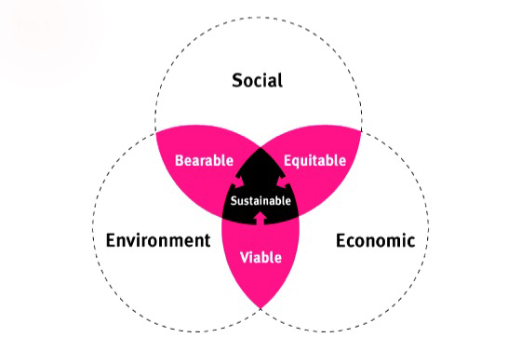
Skills for sustainability are conceived as including skills for social, economic and environmental sustainability

Slide 6
Policy and advocacy tends to respond to:
  environmental impacts of industrialisation
with
  an opportunity to grow new jobs and expand the labour market
  change existing jobs to make them greener
  (and eliminate polluting or high resource depleting industries)
For example:
  Cooperation between ACTU and ACF in Australia
  Cooperation between UNEP and ILO internationally
  Caring for Our Future
  Living Sustainably
  Green Skills Agreement

Slide 7
A number of studies find that:
Increased coordination between environment, employment and education and training policies and practices are needed
Displaced workers from some sectors will not necessarily fit into the sectors where new jobs are being created
Increased access to lifelong learning, general core skills and appropriately aligned skill formation are needed to assist workers and citizens to participate in and adjust to change
Increased dialogue between unions, workers and employers is essential for understanding the various needs as they arise

Slide 8
The research into the supply of and demand for green skills in Australia tends to focus on modelling and projections
  (what might be, not what is)
The forecasts and projections are often accompanied by case studies and vignettes
  (focusing on best practice not general practice)

Slide 9
Gen Green 4 national survey
This research provides evidence on the depth and breadth of the take-up of skills for sustainability within Australian training organisations and workplaces at the conclusion of the UN’s Decade of Education for Sustainable Development (DESD)

Slide 10
Institute Recruitment:
  Identified mix of urban & regional institutions in each state & territory
  CEOs asked to sign agreement, nominated project & marketing contacts
  18 institutes signed up from across Australia

Slide 11
Participating organisations:
WorldSkills Australia
Canberra Institute of Technology
TAFE NSW Hunter Institute
TAFE New England
TAFE NSW Sydney Institute
The Northern Sydney Institute TAFE NSW
Southbank Institute of Technology
Southern Queensland Institute of TAFE
Sunshine Coast Institute of TAFE
Tropical North Queensland TAFE
TasTAFE
Chisholm Institute
RMIT University
Swinburne University of Technology
Federation University Australia
Challenger Institute of Technology
Pilbara Institute
Polytechnic West

Slide 12
Data collection from two main groups of informants
Two online survey instruments
A rigorous analytical approach using both qualitative and quantitative data combined to identify the key insights of the respondents

Slide 13
Major premises
Apprentices and trainees are learning through both participation in authentic workplace practice and within training programs.
Apprentices and trainees come to work and training with existing beliefs and values towards sustainability
Apprentices and trainees are the skilled workforce of the future
Large corporations are increasingly choosing to publicly report on their policies and practices relating to sustainability
If a company provides evidence of addressing sustainability what do these policies and practices look like at the level of the work and training of the apprentices and trainees.
The Gen Green 4 survey is the largest national study to date and involved both, apprentices and trainees (n=649), and VET teachers (n=417) - the findings from this study provide an indication of the state of skills for sustainability at the end of the DESD

Slide 14
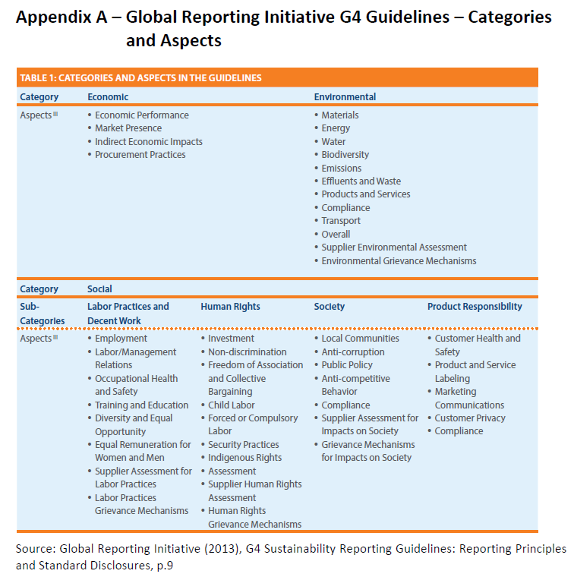

Slide 15
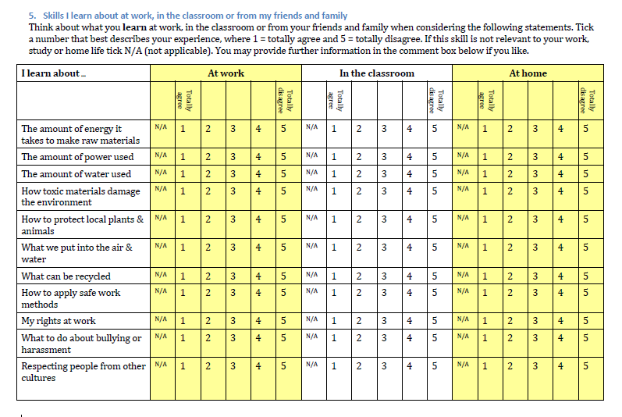

Slide 16
Apprentices, trainees and teachers responded to survey instruments that explored their:
  sustainability related values
  sustainability related behaviours
  learning and teaching of skills for sustainability

Slide 17
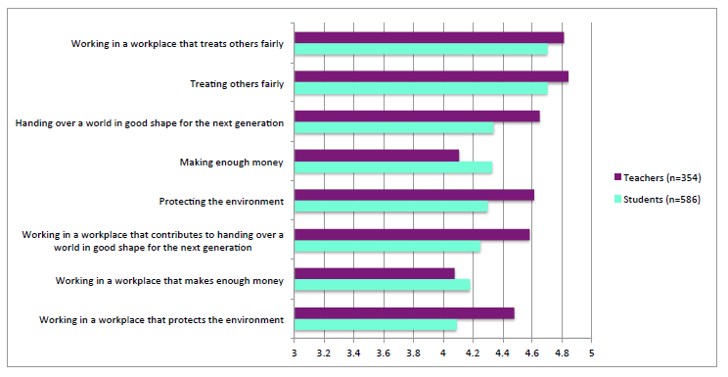
Student and teacher espoused values

Slide 18
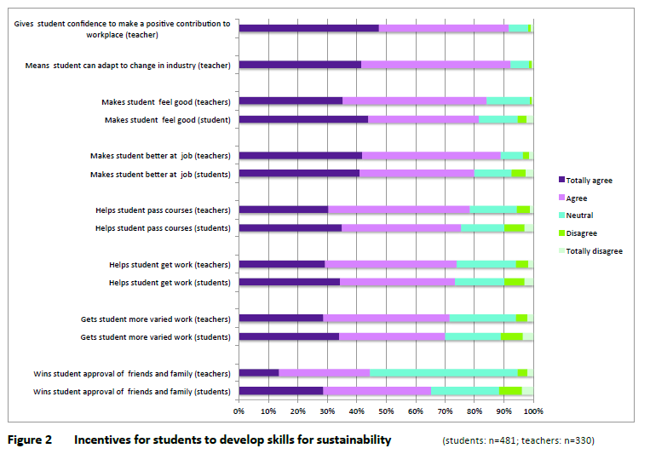

Slide 19
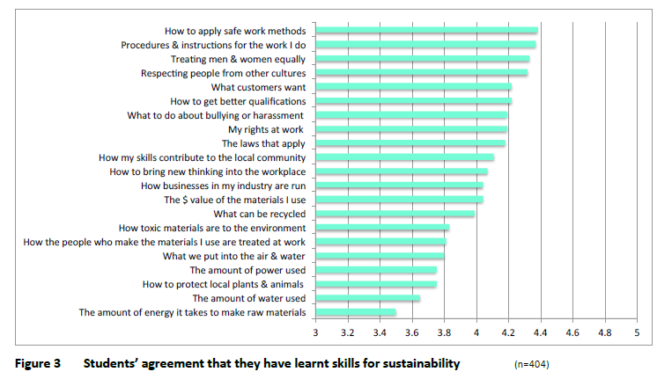

Slide 20
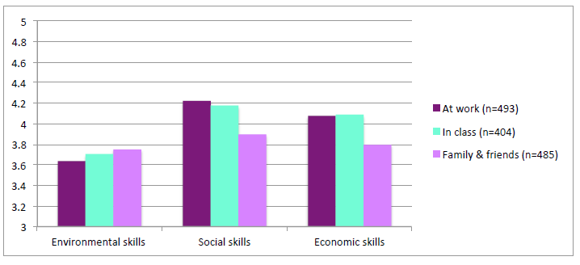
Students’ sources of learning environmental, social and economic skills

Slide 21
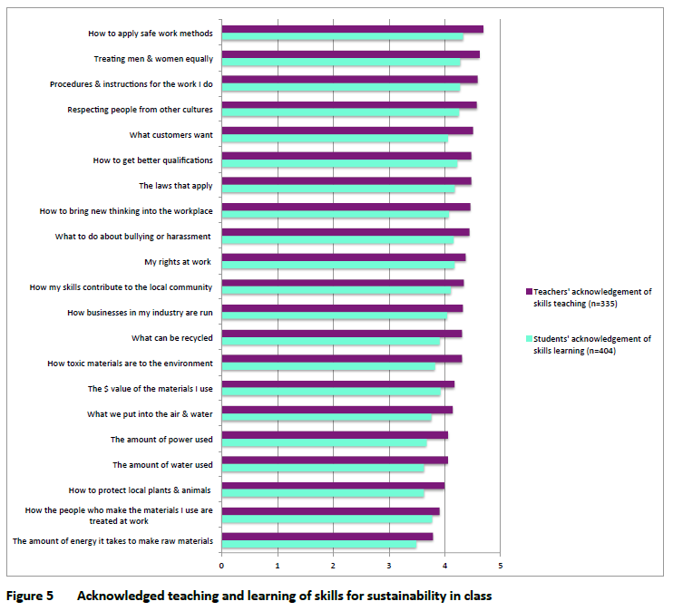

Slide 22
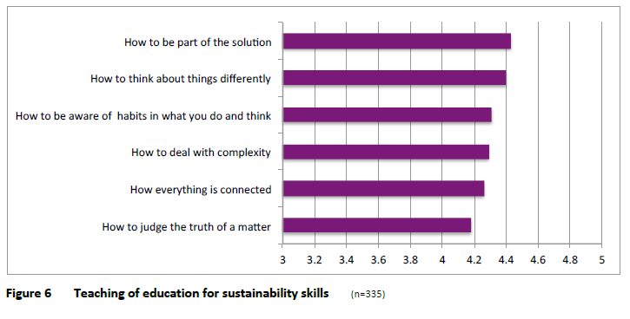
Teaching of education for sustainability skills

Slide 23
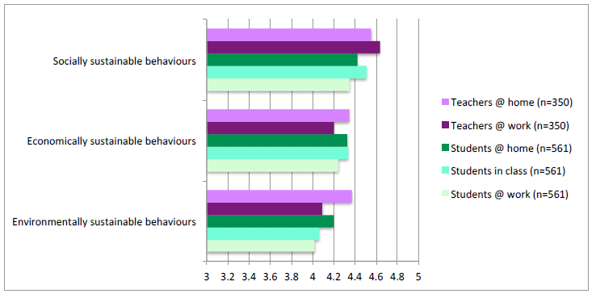
Students and teachers’ practice of sustainability-related behaviours in class, at work and at home

Slide 24
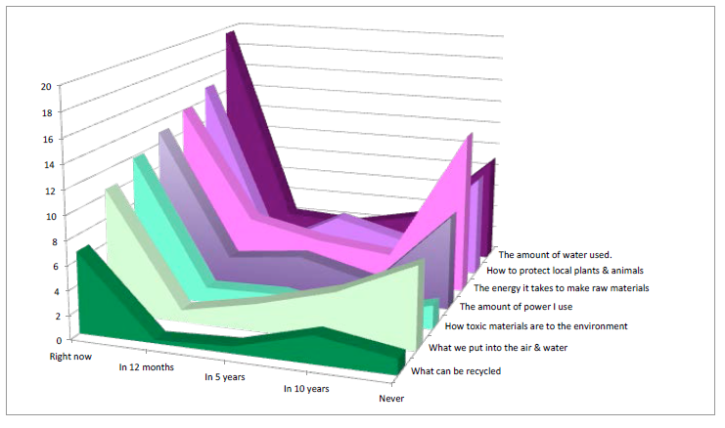
Views of students without environmental skills on demand over time for these skills

Slide 25
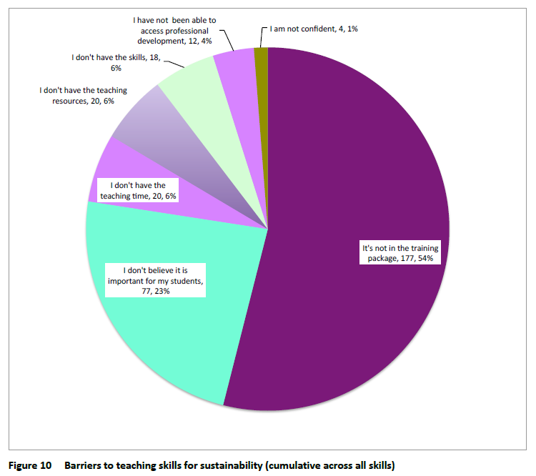

Slide 26
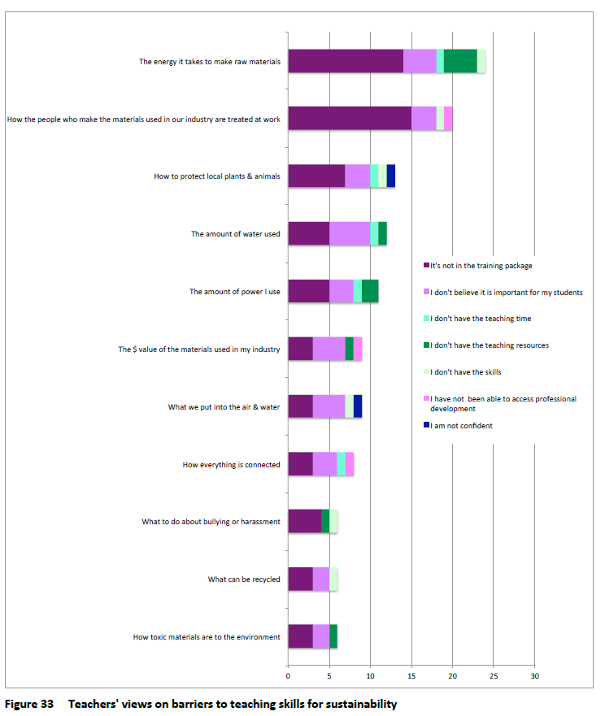

Slide 27
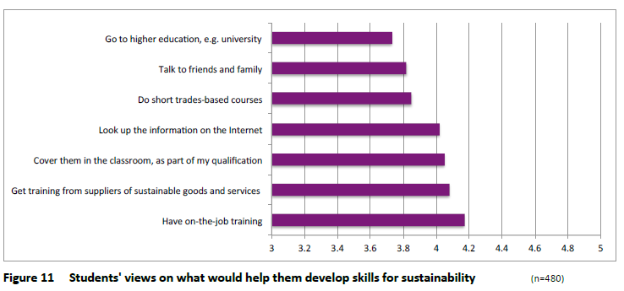

Slide 28
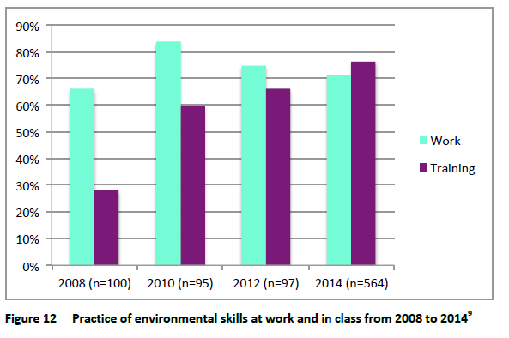

Slide 29
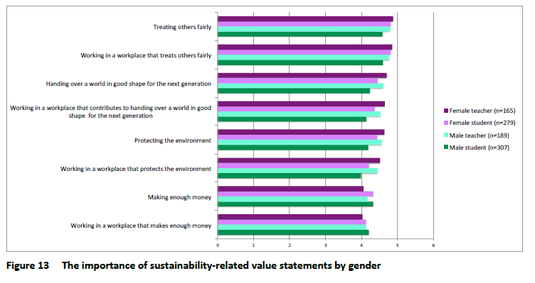

Slide 30
The impact of student age on environmental skills learning from different sources

Slide 31
Sources of learning skills for sustainability for male and female students

Slide 32
Gender differences in values and behaviours
and
gender and age differences in learning skills for sustainability have important implications for the design of future ‘skills for sustainability’ programs

Slide 33
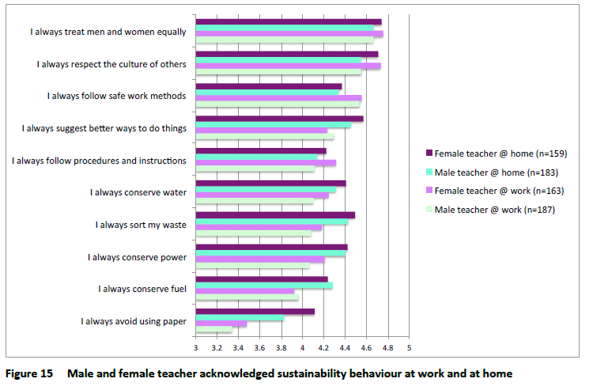

Slide 34
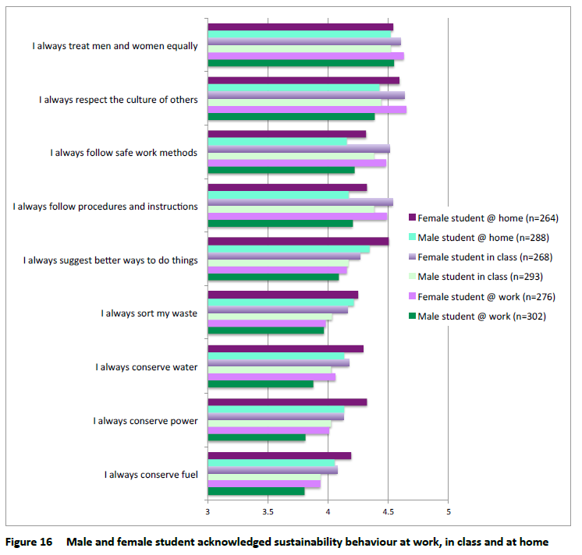

Slide 35
Conclusions
The results of this study show ‘a social demand’ for skills for sustainability:
  Apprentices, trainees and their teachers cared a great deal about social, economic and environmental sustainability
  Demand for skills for sustainability from VET students was almost entirely met

Slide 36
Further action is required to embed green skills into the VET system, especially in the areas of energy efficiency and supply chains

Slide 37
The research:
  Identifies possible features of the next generation of skills for sustainability policy
  Flags a need to better understand the relationship between the economic demand for skills for sustainability expressed by employers and the social demand expressed by VET participants.

Slide 38
As participants in both training and work Australian apprentices and trainees, and their trainers, have insight into the supply of & demand for skills for sustainability
Their considered responses provides a unique insight into the world of work and training, which is not often considered
This insight can contribute to the further development of skills for sustainability in Australia

