Slide 1
Meeting client demand for health service providers: a service design approach
David McLean
RMIT
09.04.15

Slide 2
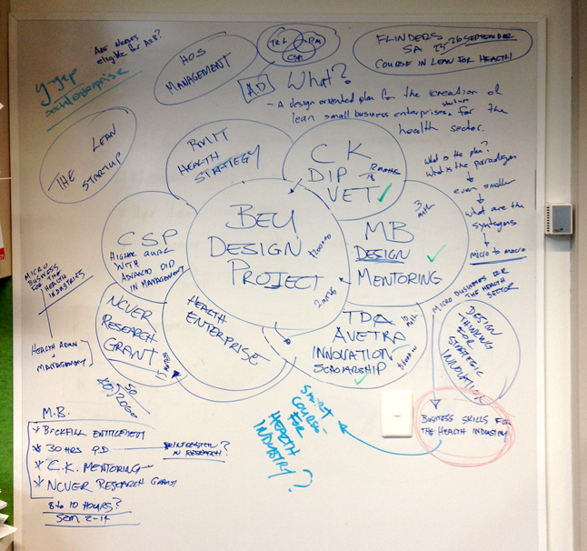
Origin
An idea in a group of ideas

Slide 3
TAFE Directors Australia/AVETRA Innovation Scholarship 2014
…aims to foster innovation in industry workforce development initiatives. Recipients will investigate innovative ways to meet new and emerging skill needs through projects in industry or community settings. The outcomes will inform new practices and/or partnerships models for TAFE and specific industry/community sectors

Slide 4
The value of practitioner research
“The macro- and micro-organisational and individual influences on the design of a practitioner-led research and development project interweave and affect each other to form a rich picture. By investigating emergent issues, some of the important implications of this rich picture are informing.” (Costley & Armsby 2007, p.133)
Practitioner-led research and development, with its own epistemologies and hybrid methodologies, draws upon existing methodological frameworks but rarely uses them in their pure form.”
(Costley & Armsby 2007, p. 133)

Slide 5
Framing innovation
Adaptation not invention
Large radical innovation : Policy & technology
Smaller incremental innovation: operational & connected
Radical policy driven innovation has made VET a site of constant incremental innovation. By necessity innovations are required to survive in a competitive open market.

Slide 6
The idea
Research in this project will determine what professions in the HCSI are best suited as micro-business start-ups. It will then explore a range of funding methods and training models that could provide mentored small business education to individuals that are already qualified for work in the HCSI but are better suited to providing services as a micro-business

Slide 7
More simply
Is an enterprise development program useful for the community service & health industry?
What would it look like?
Who would it target?

Slide 8
CS&HI
From literature reviewed on the sector:
Most significant career growth is in aged and disability care
Challenges in:
Meeting training demand
Attracting potential carers
Replacing aging work force
Low pay \ high casualisation \ part time
Providing professional development
NDIS driven change

Slide 9
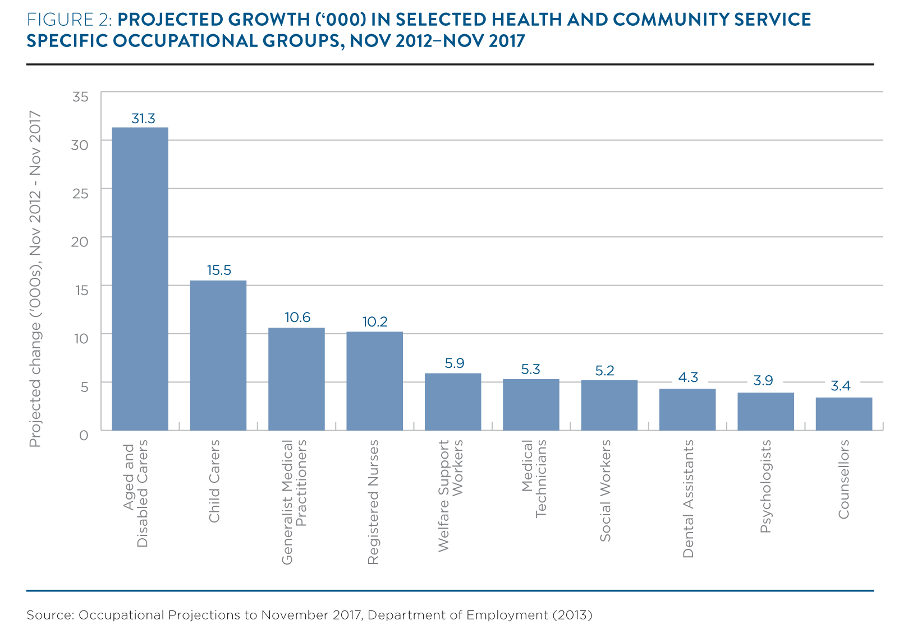
Projected Growth
Source: Community Services Health and Industry Skills Council 2014, Environmental Scan 2014: Agenda for change, Sydney.

Slide 10
The NDIS
National Disability Insurance Scheme (NDIS)is radical social innovation
Made operational through incremental innovation
A key feature of NDIS is user-choice funding
Recipients of funding will be able to not only choose the carers that they need but the type of care that they want.
“Population ageing is increasing service demand and the adoption of consumer directed funding models will transform the way services are delivered (Community Services Health and Industry Skills Council 2014, p. 4).”

Slide 11
The Problematic
Australia experiencing growing demand for carers
Existing funding model for disability care workforce has been disturbed
Existing providers will need to review business models
Clients of care will need to understand the new funding options as well as their obligations as potential contractors or employers of carers.
Carers operating as contractors will need to increase their knowledge of small business operations including:
Contracts
Financial management
Customer service
Resource management
Policy & reporting

Slide 12
The Problematic
Carers operating as contractors will need a additional skills other than the technical capability they already have.
Mentoring is an effective and preferred learning option for workers in the CS&HI*
Skills required are effectively those of a contactor or micro-business operator.
Australia has had a successful enterprise development program for over 30 years
See:Choy, S, Billett, S & Kelly, A 2013, 'Engaging in continuing education and training: Learning preferences of worker-learners in the health and community services industry', Australian Journal of Adult Learning, pp. 68-89.

Slide 13
Commonwealth Enterprise Schemes
The CWA has operated enterprise creation programs since 1985
The New Enterprise Incentive Scheme (NEIS) is the longest running.
The Apprenticeship to Business Owner program had a short run from 2013-2015
Data on NEIS programs have shown a high level of success for graduates

Slide 14
Features of NEIS & A-to-B
Conditional eligibility
Presentation of a business plan
Training in a small business qualification
Implementation of the business plan
12 months of mentoring during the establishment of the business.

Slide 15
Employment outcomes by business type
Source: Crooks, S, Cameron, M & Asgari, M 2008, New Enterprise Incentive Scheme Longer-term Outcomes, Department of Educaion, Employment and Workplace Relations, Canberra.

Slide 16
Employment outcomes by business type
2008 study showed:
6% of all NEIS participants commenced business in the CS&HI
79% of graduates had commenced a small business operation after 3 months
11% had found employment in the CS&HI, total 90% employed
65% were still operating their own business after 16 months
17% employed for a total of 82% employed.

Slide 17
RMIT NEIS Data
Table 1: conversions of RMIT NEIS enrolments to business startups
2011 |  |  | 2012 |  |  | 2013 |  |  | 2014
Enrolments | Actual startups | % Business startup | 2012 Enrolments | Actual startups | % Business startup | Enrolments | Actual startups | % Business startup | Enrolments | Actual startups | % Business startups
229 | 212 | 93% | 237 | 215 | 91% | 230 | 212 | 92% | 251 | 226 | 90%

Slide 18
RMIT A-to-B Data
Table 2: conversions of A-to-B enrolments to business startups.
2013 |  |  | 2014
Enrolments | Actual startups | % Business startup | Enrolments | Actual Startups | % Business Startups
29 | 24 | 83% | 226 | 201 | 89%

Slide 19
Success through Mentoring
It is the mentoring component inclusive of the training program that sets NEIS and A-to-B apart.
Mentors in these programs are drawn from successful practitioners and business people
There is a range of research that shows the importance of mentoring on the success of people entering the work-force.

Slide 20
A model
The model proposed would not be dissimilar to either the NEIS or A-to-B programs.
Eligibility for the program is dependent on applicants already holding the appropriate qualifications to work as disability carers.
Fees would be paid by the federal government
Participants would develop a business plan and then have mentoring provided for the first 12 months working as contractors.

Slide 21
The argument is
If you are going to invest in change to ensure the success of a radical innovation you need to invest in appropriate supported skill development.
A training program that is designed fit-for-purpose is likely to contribute to the change and minimise churn

Slide 22
Thank you
Many thanks to AVETRA and TDA for supporting me in this research.
Much appreciated.

