Slide 1
This is it folks, over the top! How do we lead from the frontline in the changing vet environment? What skills and capabilities do our frontline vet educational leaders require?
Linda Simon and Annette Bonnici

Slide 2
Main findings of our NSW research 2011
Head Teachers in TAFE NSW valued their positions which mixed teaching and leadership
Most important aspects of their roles were:
> educational leadership
> section management
> increasing quality in teaching
> working with industry and other providers
> supporting innovative teaching and learning practices

Slide 3
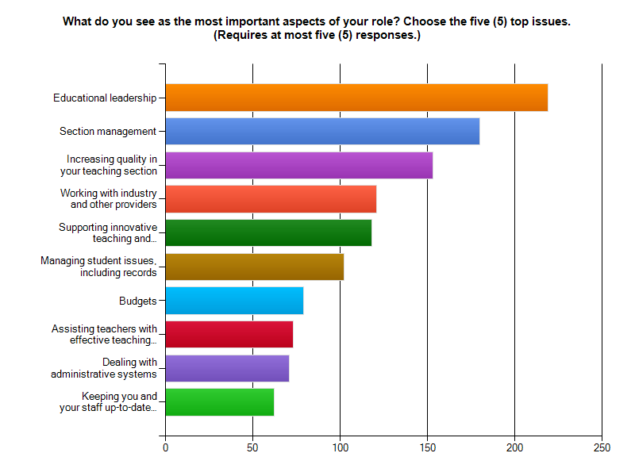
Most important Aspect of the role

Slide 4
What further skills and capabilities did they say they needed?
Financial management skills
Technological skills
Skills in eLearning or use of other technologies
Entrepreneurial skills
Ability to prioritise workload
Leadership skills
Ability to effectively work with industry
Skills to assist in dealing with an increasingly diverse range of students
Skills in designing and delivering
Ability to interpret and implement

Slide 5
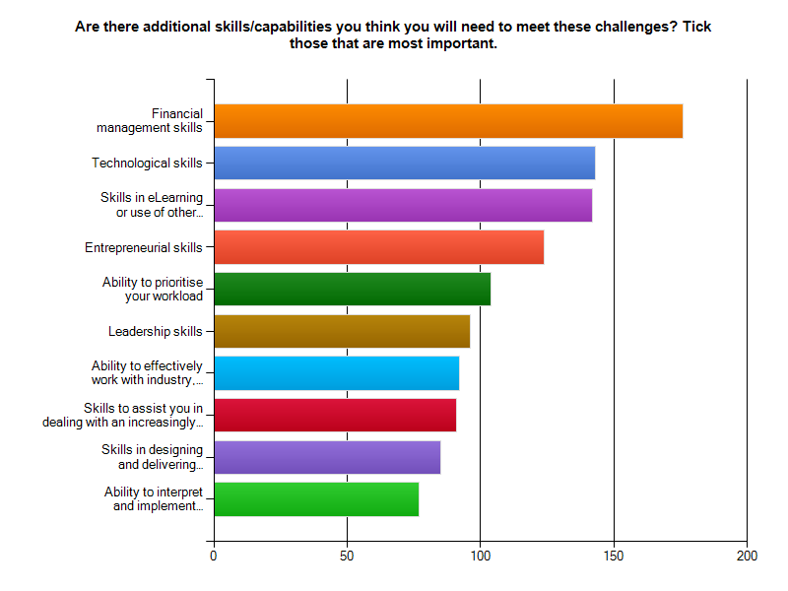
What further skills and capabilities did they say they needed?

Slide 6
What do others say about similar positions?
CEDEFOP
In European countries surveyed, VET leadership positions required formal qualifications, generally at tertiary level
VET leaders had a strong connection with the world of work
They required vocational and pedagogical skills and qualifications

Slide 7
Others said:
VET leaders required:
flexibility and innovation
ability to manage financial resources, data and people
ability to work with industry and community partners
strong commitment to quality assurance
NCVER report 2007
ability to communicate a vision for the organisation
ability to build successful teams
sound strategic thinking and planning skills
ability to inspire staff to make a commitment to change

Slide 8
Research methodology
Study of industrial Awards and/or Enterprise Agreements
Interviews with union officials, professional development experts, managers and teachers/lecturers holding leadership positions
Issues included difficulty in accessing TAFE
educationalists in other states and territories, and the
different roles and names of educational leadership
positions

Slide 9
South Australia
Separate teaching and management streams
Principal Lecturers -educational and vocational leadership
Lecturers Level 8 - 25% reduction in contact hours
Highly skilled educational leaders with excellence in academic leadership and strategic directions
Hold BEd (Adult, Vocational and Workplace Learning) or equivalent
Expansion in casualisation and increased admin function made positions difficult
Need skills it technologies and good people mgt

Slide 10
Western Australia
Teaching and management roles separated
Principal Lecturers and Adv Skills Lecturers – leadership roles
Need higher edn quals and vocational quals than teachers
Principal Lecturer – is a teaching position with college or system wide edn leadership expertise
Role includes educational leadership in curriculum across program areas, professional practice and educational innovation, maintain close liaison with industry and professional groups, give advice on current trends in area, and represent on college, state and interstate working groups

Slide 11
Queensland
Separation of educational and administrative managers
Educational Manager or Program Manager expected to have teaching qualification, but actual teaching role up to local negotiation
Role includes managing delivery team
Leading vocational teacher takes on additional duties for more pay – including leadership in teaching practice, team leadership, performance planning, industry liaison, international, marketing, functions
Problems with unofficial leadership model – some leading vocational teachers want career pathways

Slide 12
ACT
Some Educational Managers (Teacher Band 2) still have a teaching role – they manage program areas including staff
Required to have Adv Diploma in Adult Vocational Education or equivalent – degree is desirable either in education or management or industry area
Critical workload issues due to increasing bureaucratic systems and changing VET
Band 2 network has monthly meetings focused on their roles
Business management skills would be useful

Slide 13
Victoria
4 streams of Senior Educator – teaching, industry consultancy, curriculum and project design, and management
3 levels for each stream
Roles vary across TAFE Institutes
Industrial Agreement sets down skills and capabilities required: conflict resolution, negotiation, teaching, leadership role in teaching methodologies, current/emerging trends, evaluation/validation of programs/systems, quality control, research/innovation, specialist expertise
Must be fully qualified – Diploma level

Slide 14
Victoria
Interviews:
Co-ordination of teaching section – undertaking Masters – helps understanding current changes in VET
In charge of college wide area, plus teaching role – felt SEs needed project and financial mgt skills
Managed number of teaching areas – felt SEs needed edn degrees and counselling/welfare skills
Managed a program area, plus teaching role – doing Masters in Edn Mgt but more schools focused – a program in workplace developing mgt skills had been useful

Slide 15
Victoria
Managed number of areas – strong commercial bent to role – international a challenge
Managed a section and program area – leadership skills needed to manage staff
Co-ordinated teaching area plus teaching role – also mgt qual. Skills in change mgt useful
Managed teaching programs across campuses – SEs need to be expert communicators – training in mgt and budgeting would be useful
SEs needed leadership or management qualification, along with a business leadership focus

Slide 16
CONCLUSIONS
TAFE frontline educational leaders share the same concerns about roles, and skills and capabilities needed
Strong support for continued teaching or edn part of role – opposition to generic mgt/leadership
Recognise value of educational qualifications – university level
Many indicated need for additional skills that focused on management aspects of role, and needs of changing VET sector
Need time to gain post grad quals and participate in workplace focused programs

