Slide 1
Pathways
following the highway, taking the scenic route or journeying through the dreaming
Eva McRae-Williams
CRC-REP / Batchelor Institute
John Guenther
CRC-REP / Flinders University

Slide 2
Cooperative Research Centre for Remote Economic Participation
Goals:
To develop new ways to build resilience and strengthen regional communities and economies across remote Australia.
To build new enterprises and strengthen existing industries that, provide jobs, livelihoods and incomes in remote areas.
To improve the education and training pathways in remote areas so that people have better opportunities to participate in the range of economies that exist.
For more info see http://crc-rep.com/

Slide 3
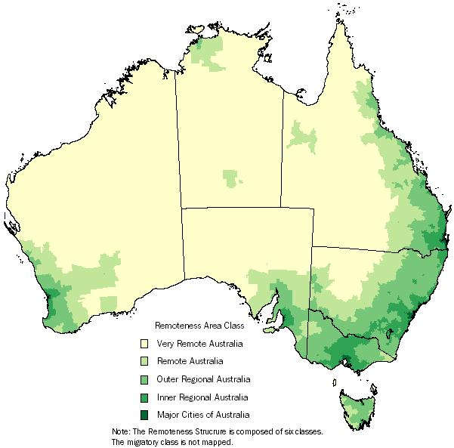

Slide 4
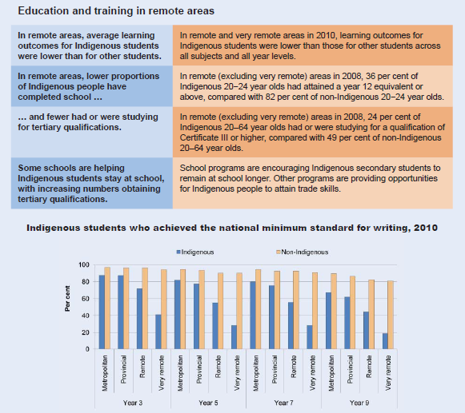
Steering Committee for the Review of Government Service Provision 2011. Overcoming Indigenous Disadvantage: Key Indicators 2011, Fact Sheet--Remote Areas, Productivity Commission. Canberra, Retrieved August 2011 from http://www.pc.gov.au/__data/assets/pdf_file/0012/111612/key-indicators-2011-factsheet-remote.pdf.

Slide 5
The “Pathways to Employment” project
Initial stages of development
5 year project (2012-2017)
Focusing specifically on Aboriginal and/or Torres Strait Islander peoples residing in ‘very’ remote Australia
Approximately 10 Case studies
Aim: to provide a systemic understanding of effective pathways to work and enterprise in remote Australia, identifying the factors that support transitions into sustainable employment and the barriers to effective transitions. It will compare and contrast the strengths and weaknesses of existing approaches in securing sustainable employment outcomes for Aboriginal and Torres Strait Islander people; and document Aboriginal and Torres Strait Islander job seekers’ perspectives about effective supports for successful employment transitions. The impact from the project will be removal of existing barriers and newly designed pathways to work and enterprise in remote Australia that are client focused.

Slide 6
A word of caution
The authors do not purport to represent Aboriginal and Torres Strait Islander positions on the issues presented here.

Slide 7
Assumption 1: A to B Pathways?

Slide 8
Assumption 2: More knowledge needed about ‘Barriers’?
Lack of education/training and employment opportunities in local area
Poor or inappropriate education/training program development, implementation and delivery
Cultural barriers
Low levels of English literacy and numeracy skills – educational and language disadvantage
A lack of basic skills such as drivers licence and job search skills
Personal and social health issues

Slide 9
Assumption 3: The Meaning and nature of Work
Most people spend almost all of their time working, resting from work, or spending the money they earned working. A life that is not fully taken up with work and consuming seems to offer not only boredom but also purposelessness (Beder 2000: 266)
It is easy to see why – aside from the income it provides – having a job is so desirable in our culture. Work works for us. It offers instant discipline, identity, and worth. It structures our time and imposes a rhythm on our lives. It gets us organised into various communities and social groups. And perhaps most importantly, work tells us what to do everyday. Even with education, income, peace, and security the free choice not to work is difficult in a culture where paid work is so central to life (Cuilla 2000: 8)
Look those mununga [white people]. Like chooks with their heads cut off, playing at being busy
(field notes - Aboriginal Man Age 50, McRae-Williams 2008: 188)
You work for yourself, take responsibility for yourself, or maybe just your little family. I [am] always working for family, that’s my main job, being responsible to family. Mother’s side, father’s side, husband ones, always working to show them I love and respect them. Then I know they will be there for my son and be working for him
(field notes – Aboriginal Women Age 28, McRae-Williams and Gerritsen 2010: 9)

Slide 10
World views and ‘successful transitions’
Ontology: ways of being
Epistemology: ways of knowing
Axiology: ways of valuing
Cosmology: the nature of the universe
Concepts which allow for a broader interpretation of the meaning and purpose of education, vocation and employment
Learning and Livelihoods

Slide 11
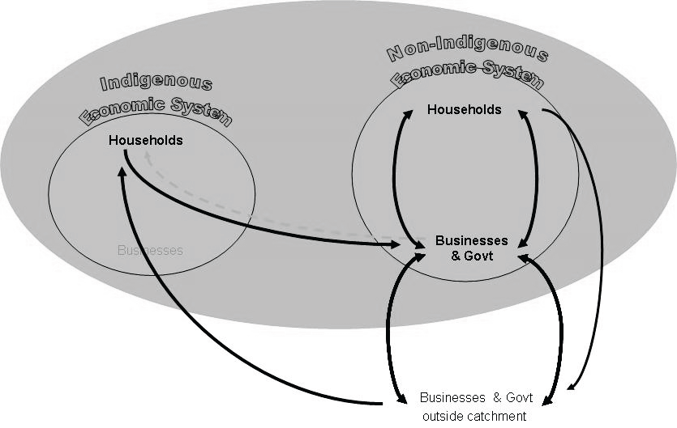
Assumption 4: Increasing Economic Participation?
Stoeckl (2011: 112) The Great Asymmetric Divide

Slide 12
Some Issues to Consider…
the assumption of a lack of economy in remote locations and the associated notion of a lack of participation in the economy
why a different form of economy is assumed necessary and what it actually is about the welfare-based economy that is viewed and experienced as so problematic
why having an economy principally based on participation in employment, is assumed essential.
why the strong assimilative forces behind economic participation agendas focused on employment and enterprise development are rarely openly acknowledged or meaningfully discussed
whether the mainstream system has the ability to acknowledge and accommodate different ways of being and notions of vocation and employment beyond simply rhetoric

Slide 13
Pathways Project Conceptual Framework

Slide 14
Research Questions
Research Focus
Problematising the ‘problem’: challenging mainstream assumptions (central ontologies)
Questioning the nature of and investigating the possibilities around meaningful learning, vocation and employment opportunities
Exploring effective work-readiness and career development approaches
Behavioural change
The role of technology for creating and supporting pathways and livelihood outcomes
More specific case studies will focus on:
Young peoples (15-25) transitions from education to employment and their aspirational livelihood trajectories
Incarceration and the prison systems relationship to pathways to employment & livelihood outcomes
The relationship between disability and livelihood aspirations and outcomes
Enterprise development projects
Ranger training and livelihood pathways
Police training and livelihood pathways
1. How do Aboriginal and/or Torres Strait Islander people who reside in remote communities navigate their way into meaningful livelihoods?
2. What kinds of work help to support sustainable livelihood outcomes?
3. What kinds of learning support meaningful livelihood agendas and aspirations?

Slide 15
Contacts
CRC for Remote Economic Participation
http://crc-rep.com/
Eva McRae-Williams
eva.mcrae-williams@batchelor.edu.au
0400 759 153
John Guenther
john.guenther@flinders.edu.au
0412 125 661

