Slide 1
Developing green skills through TAFE across Victoria
AVETRA Canberra 2012
Dr Mike Brown
LaTrobe University
Faculty of Education

Slide 2
Three key questions . . .
How are job roles changing in the transition to a low carbon economy?
How are TAFE training programs changing to develop ‘green skills’?
How are the TAFE staff’s professional development needs for understanding green skills, being met?

Slide 3
A brief overview . . .
An overview of the study
Context and background
Other literature, other studies
Methodology
Findings
Discussion
Conclusions

Slide 4
Further research
A larger study with a national sample of VET providers to investigate how job roles and work practices are changing along with a review of how the development of green skills is occurring
In situ methodological carriage

Slide 5
A brief overview . . .
The push for change: the need to transition to a low carbon economy
Some of the big picture arguments from Giddens (2011) and Chandler (2011)
The Australian response

Slide 6
The push for change . .
the need to transition to a low carbon economy
The GSA and the GSA Implementation Plan
This paper starts to explore the extent to which green skills are being developed through some TAFE Institutes in Victoria.

Slide 7
a quote from Jo Chandler (2011:4)
Ice core data (primarily from Antarctica) tells us that for all human history, atmospheric CO2 was around 275 parts per million (ppm) until about 200 years ago, when civilization began to dig up and burn coal to fuel the industrial age. Today the CO2 level recorded at the Mauna Loa Observatory in Hawaii – the longest record for direct atmospheric measurements is nudging 390 ppm, well over the 350 ppm many scientists and some governments now identify as the ‘safe’ upper limit, and which was last seen around 1988. Turning the ship around will be some feat, one which gets harder with every passing day, though we are assured it’s not impossible, assuming there is the will to do it.

Slide 8
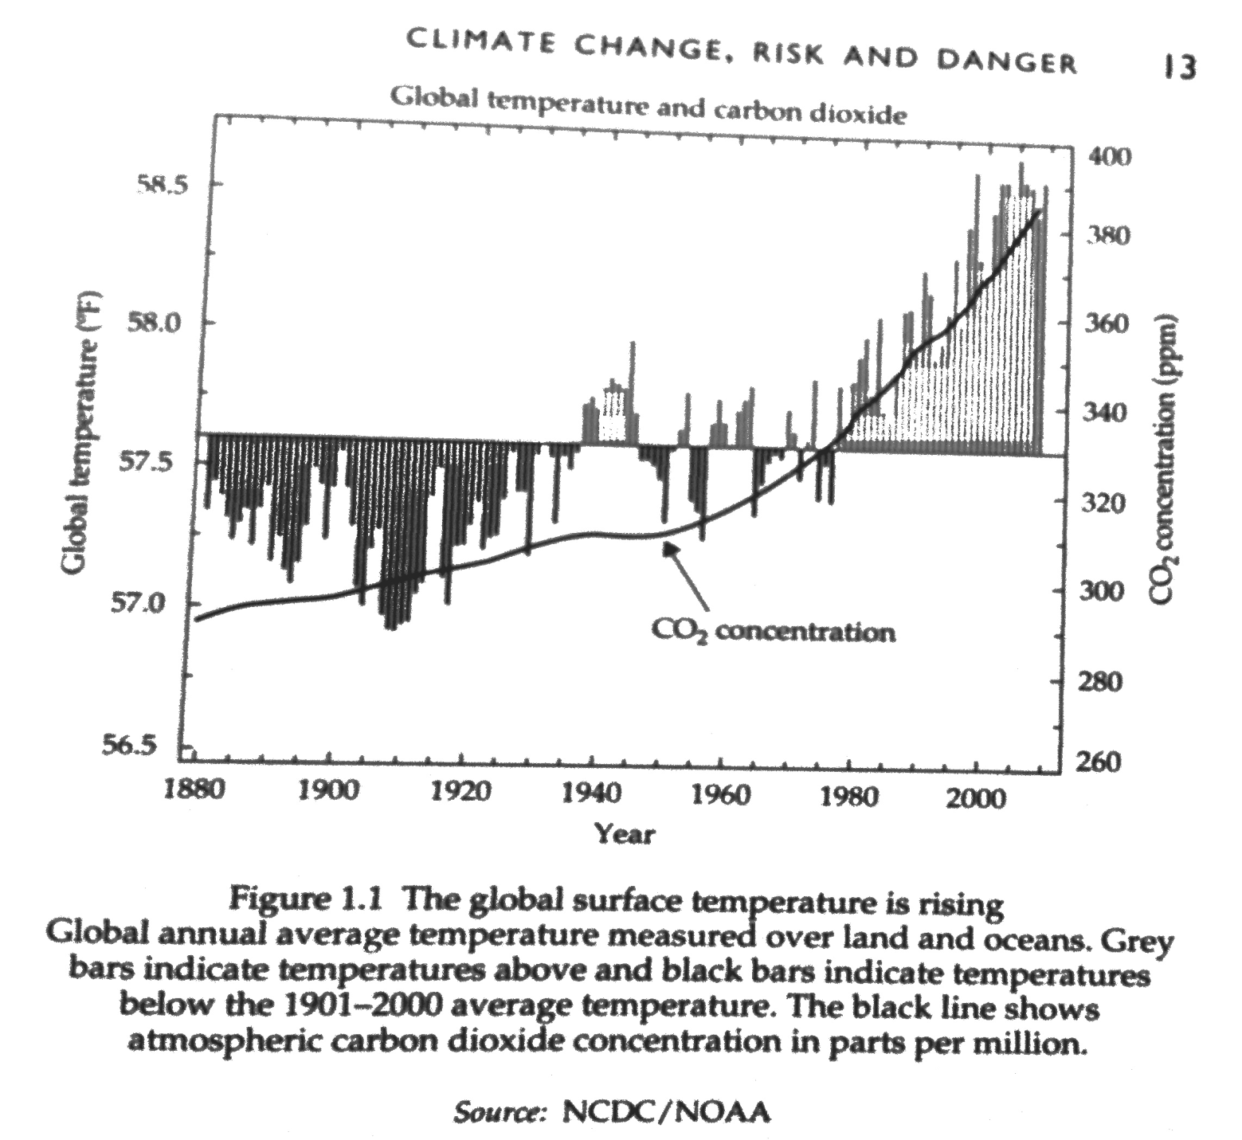
Some graphics from Giddens 2011

Slide 9
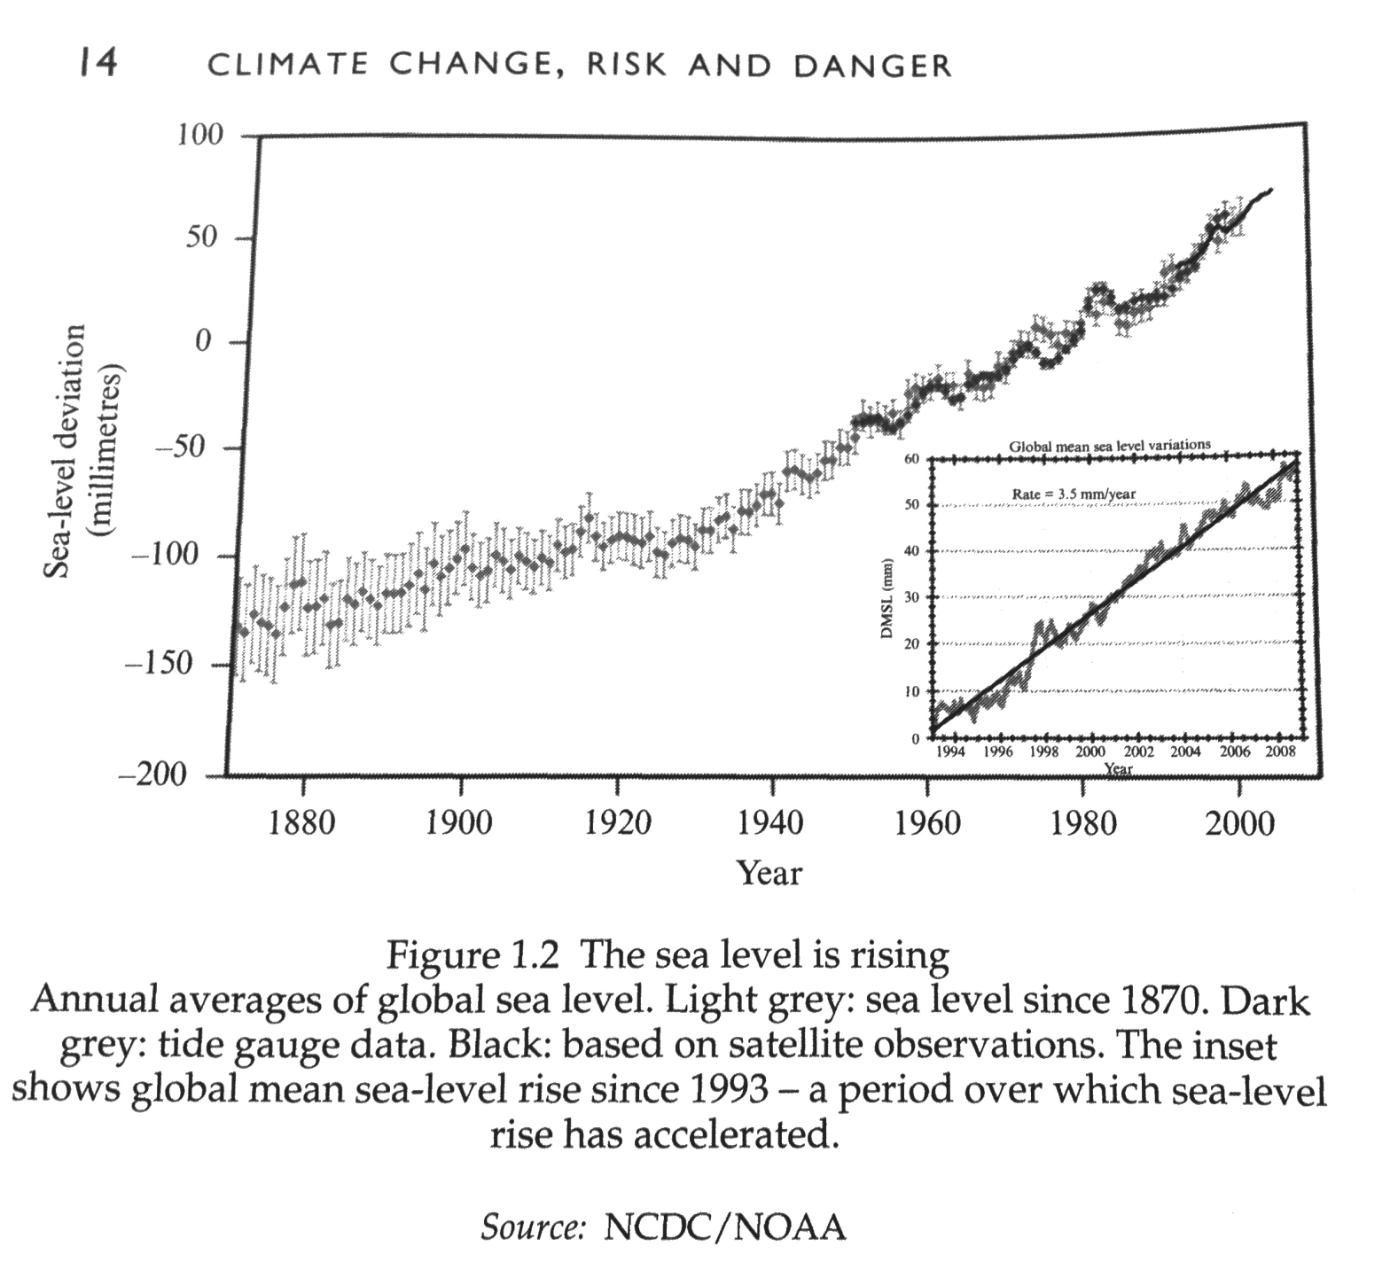
Some graphics from Giddens (2011)

Slide 10
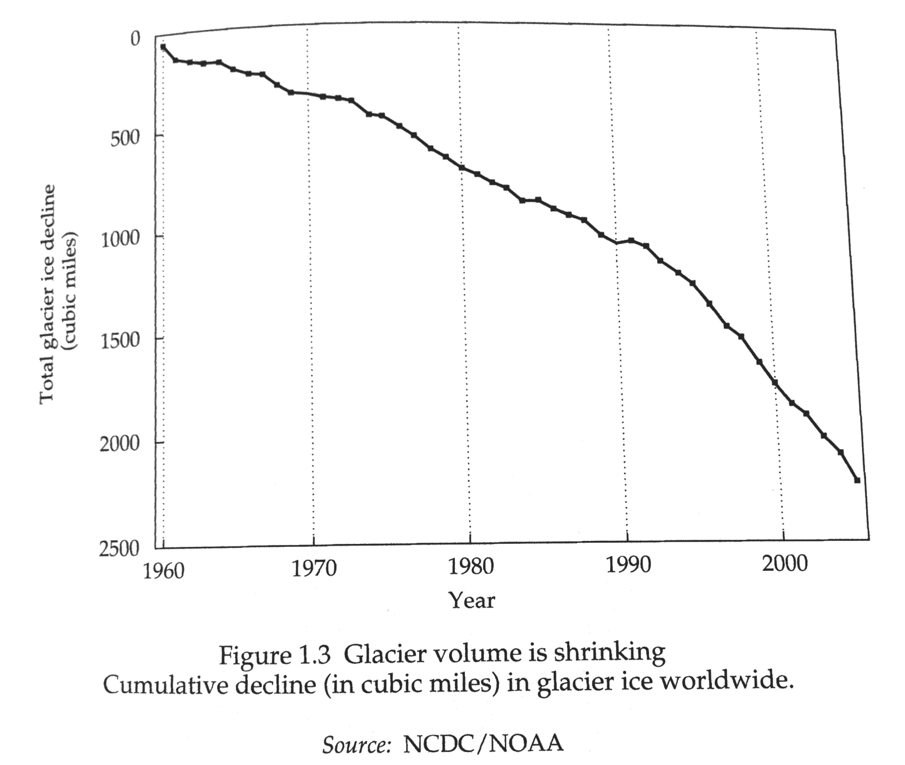
Some graphics from Giddens (2011)

Slide 11
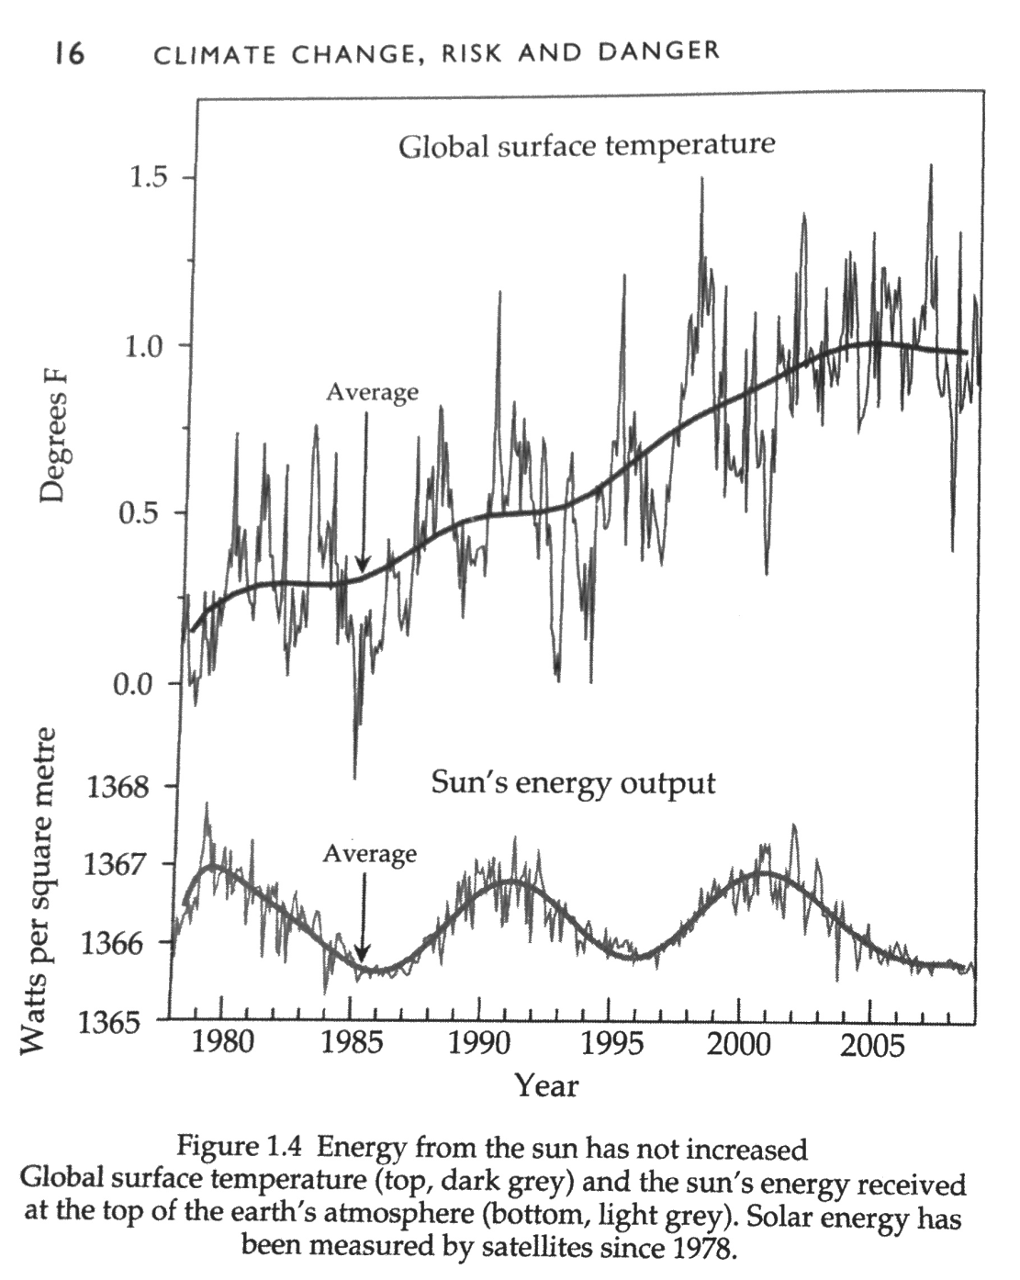
Some graphics from Giddens (2011)

Slide 12
Context and overview
The UNEP (2011) report defines the Green Economy as ‘an economy that results in improved human well-being and reduced inequalities over the long term, while not exposing future generations to significant environmental risks and ecological scarcities’ (pg.2).
DEEWR (2011) in their report on Australian Jobs explains, ‘green skills, or skills for sustainability, are the professional and vocational skills, as well as the generic skills (such as sustainable approaches, innovation and problem solving) required for new green jobs and the greening of existing jobs across all industry sectors as a response to climate change and sustainability imperatives’ (DEEWR 2011: 31).

Slide 13
Context and overview
Climate Commission (2011) ‘this decade is critical’ and Australia must decarbonise its economy and move to clean energy sources by 2050. The longer we wait the more difficult and costly it will be. This is the basis of calls for a transition to a low carbon economy. High amongst the strategies to do this is the setting of targets for a lowering of carbon and pollution emissions, and also targets for the levels of alternative and renewable energy being used. This paper starts to explore the extent to which green skills are being developed through some TAFE Institutes in Victoria.

Slide 14
Other literature . . . other studies . . .
The GSA: the Green Skills Agreement
The development of green skills
  What, where, how and why
The development of green skills within VET
  Training packages, programs
  VET students and graduates
  Professional development of VET teachers and managers

Slide 15
Other literature . Green collar work
Climate Institute (2011)
Rafferty & Yu (2010)
ACTU (2008)
Hatfield-Dodds et al (2008)

Slide 16
The development of green skills
What, where, how and why
GSA and GSA Implementation Plan
GSA has four objectives
Donavan (2010) summarised these as, the development of national standards, upskilling the VET workforce, revision of training packages, and transition strategy for vulnerable workers.

Slide 17
The development of green skills within VET
Training packages, and VET programs
  (Toohey 2010)
VET students and graduates
  DSF 2008 & 2011; Sack 2012
Professional development of VET teachers and managers
  Ithaca Group 2011

Slide 18
Methodology
Three key questions . . .
How are job roles changing in the transition to a low carbon economy?
How are TAFE training programs changing to develop ‘green skills’?
How are the TAFE staff’s professional development needs for understanding green skills, being met?

Slide 19
Methodology
Four groups of participants,
    Industry and community stakeholders (20);
    VET managers (20)
    TAFE teachers (22)
    TAFE students (19)
Sample size of eighty-one (N=81)
Semi-structured focus group or individual interviews, around 30 minutes each, fully transcribed, and thematically analysed

Slide 20
Further research
A larger study with a national sample of VET providers to investigate how job roles and work practices are changing along with a review of how the development of green skills is occurring
In situ methodological carriage

Slide 21
Tentative Findings: industry and community stakeholders
Transport and logistics
Pastry-cooking and baking
Timbertown in Gippsland
CEOs of Energy companies
Local councils
A plant operator
Alternative Energy retail suppliers and installations
Sustainability Victoria
Master Plumbers Association:

Slide 22
Tentative Findings: industry and community stakeholders
Four main drivers:
lower costs and the business case;
A viable alternative
Better for health and wellbeing
Better for the environment and part of the transition to a low carbon economy (but don’t say ‘green’)

Slide 23
Tentative Findings: TAFE managers
Generally no worries changing and making adjustments
‘Just tell us what you want and we will do it’
Implementing changes to training packages, changes to courses and programs
Two Hospitality departments at two different TAFEs
Full support and finding money, to no support and wont even bother looking for money
Generally very supportive of PD

Slide 24
Tentative Findings: TAFE teachers
Jobs changing and adaption:
Childcare industry, new call to educate the four year olds;
Plumbing: Master Plumbers Assoc; new products and new practices, bulk buy strategies, some real champions
Electrical: made an off grid simulation, the trailer
Building trades: bricklayers, carpenters,
Performing arts: travel is an issue.
Cooking hospitality
Farming: new practices, water usage, tree planting ??
Sustainability Officers in large companies
Some teachers more than others
There is evidence of many initiatives but it is still possible to have no change

Slide 25
Tentative Findings: TAFE students
Plumbing,
Electricians,
Signwriter,
Carpenters,
Cabinetmakers,
Land management and conservation,
Renewable energy students,
Boatbuilder

Slide 26
Tentative Findings: TAFE students
Generally seeing some changes
Double agendas of cutting waste and inefficiency which also cuts costs – the business case
Green skills being incorporated into their courses in general and specific ways.

Slide 27
Conclusions
This study analyses data from four categories of stakeholders and participants in order to provide insight into the actual perceptions and practices around sustainability across five TAFE Institute.
Some new jobs are emerging and while these are thought likely to increase in the future, most change is occurring within existing jobs and in the application of the skills.
Clearly markets are growing in renewable energy, energy efficiency, sustainable water systems, green buildings, and waste and recycling, with all jobs seemingly starting to consider and incorporate ‘skills for sustainability’.
There is evidence of many initiatives but it is still possible to have no change

Slide 28
Further research
A larger study with a national sample of VET providers to investigate how job roles and work practices are changing along with a review of how the development of green skills is occurring

