Slide 1
Make VET Great Again
The case for Competency Intelligence Based Training
for
Vocational Education and Training

Slide 2
*Research’s Design and purpose
This research was designed to address the pedagogical confusions in VET delivery, through the use of the Double Heuristic Method (DHM),
With a view to bringing clarity to VET teaching, assessment, and delivery
By capturing teachers’ perspectives of using an alternative model of pedagogy (the DHM) to address their pedagogical challenges in VET.

Slide 3
*the Contextual background of the study
Three typologies have emerged globally,
which are:
The behavioural approach in USA,
The functional approach in the UK and
The holistic approach in Germany and France.

Slide 4
*Lit Review
The literature Review was undertaken in three parts to explore VET delivery:
Internationally,
In England and
In Australia.

Slide 5
*Part 1 - International level
In 2000 - The Lisbon strategy was launched by the European Union, for Europe to become the most competitive knowledge-based economy in the world.
In 2003, they realized that: to achieve this goal they need to blend lifelong learning and competency development in VET delivery programs.

Slide 6
*Part 2 - England
The UK education system was shaken by the ‘Thatcherite revolution’ (1979-1990) leading to a plethora of white papers, called “New Vocationalism”.
2005 – They realized that VET needed reinvigoration, Foster report referred to VET sector as ‘Neglected Middle Child” and issued FE Reform White Paper.
2007 - the government realized that to achieve the goals as set by FE reform they need to focus on teacher training. Teachers needed to be licensed to teach by Institute of Learning. This did not produce high expectation.
2010 – Tomlinson was commissioned to inquire into teacher training – found two areas of neglect:
1 - VET Teachers are considered as second best in teaching profession,
2 – Neglect of vocational and applied pedagogy
Conclusion: There is a clear need to develop a theory of applied learning.

Slide 7
*Part 3 – Australia
In Australia, High Level Review established that the ability to work skillfully with the Training Packages is the key quality issue
Quality teaching requires the following understandings:
Firstly - “How the training Packages work and ,
Secondly - how to work with them” (Schofield & MacDonald & ANTA, 2004a:4-5).

Slide 8
*Summing up of Literature Review (LR)
LEVEL | FINDINGS
International | Lifelong learning + competency development
England | “Theory of Applied learning is required”
Australia | “How the Training Packages work + How to work with Training Packages”

Slide 9
This research addressed the following needs
The need for a pedagogical device that gives meaning to the understanding of competency development by clarifying the components of competency and their relationships.
1
The need to understand how to pedagogically engage with Training Packages.
3
The need to blend life-long learning and competency development pedagogies.
This research presents such a framework comprised of: DHM. Competencivism and PROPE theory, (mental GPS).
4
The need for an applied learning theory as a facilitative framework for both teaching and learning.
2

Slide 10
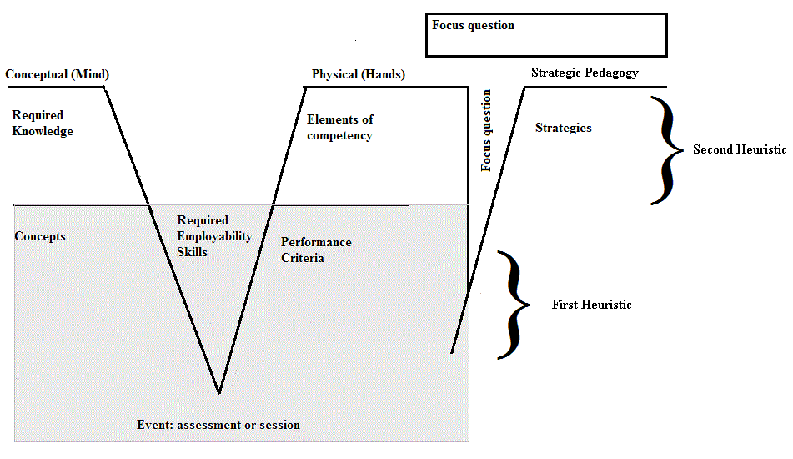
*The DHM is a pedagogical device
DHM is comprised of two heuristics:
The first Heuristic integrates Knowledge, Skills and Performance criteria
The Second Heuristic frames the First Heuristic.
The two heuristics, together, can deliver training for VET in Australia.

Slide 11
According to competencivism:
The learners are not competent when they are able to apply their knowledge and skills to performance.
The learners are competent when they have also achieved certainty, independency, currency and intelligence (they are able to perform while using the right balance of their IQ and EQ)

Slide 12
in competencivism teachers and learners needs are satisfied
The Teachers
Need
To continue assisting learners in developing competence in the framework until such time as they are confident, independent, current and competently intelligent.
The Learners
Need
To demonstrate that they have achieved the four premises of confidence or certainty (Premise 1), independence or autonomy (Premise 2), currency (Premise 3) and competency intelligence (Premise4)

Slide 13
Four Premises of competencivism
CERTAINTY -individuals engage fully in the activities of life and perform according to the certainty that they possess a special quality called competence.
Premise 1
INDEPENDENCY - to achieve certainty the individual needs to develop competency and continue on this path until he/she attains independency.
Premise 2
CURRENCY – The individual learner needs to maintain currency .
Without currency, the knowledge and skills become outdated and obsolete.
Premise3
INTELLIGENCE –The learner needs to develop competency intelligence (CQ), to balance his/her intellectual abilities (IQ) and his/her emotional competences (EQ).
Premise4

Slide 14
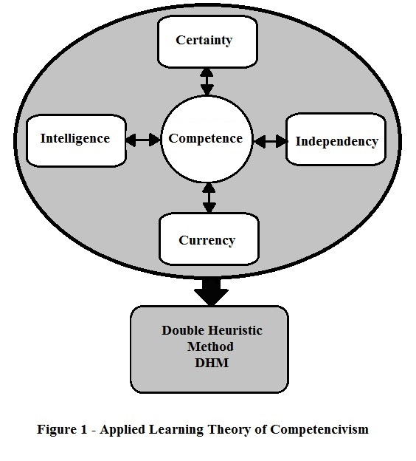

Slide 15
Research Methods
This study was designed within a qualitative tradition
was carried out within the interpretive paradigm
Adopted Symbolic Interactionist (Blumer, 1969) as its theoretical position to formulate a theory from the meanings that the participant teachers attributed to the use of the DHM in delivery of courses to their students.
A grounded theory methodology and the methods of semi-structured interviewing (O’Donoghue, 2007:85) were used in this research for data collection and analysis (2 years).
In the process of data analysis, both code notes and theoretical memos were utilised for transcription of data using open coding, leading to the identification of the initial categories (Strauss & Corbin, 1990).
This was followed by axial (to identify the relationship of concepts) and selective coding (to identify core category).

Slide 16
Symbolic Interactionism is based on three premises
The first premise of Symbolic Interactionism states that,
“human beings act towards things on the basis of the meanings that the things have for them” (Blumer, 1969:2).
The second premise states that, “the meanings of such things are derived from, or arise out of, the social interaction that one has with one’s fellows” (Blumer, 1969:2).
The third premise expresses that, “these meanings are handled in and modified through an interpretive process used by the person in dealing with the things he/she encounters” (Blumer, 1969:2).

Slide 17
*Data Analysis and Emergence of three propositions
Three propositions emerged:
The first proposition - in the context of Training Packages teachers see the Double Heuristic Method (DHM) as a clarifying approach for VET delivery in Australia. The four key concepts that underpin the proposition are: Appropriateness, Articulation, Effective Communication, and Precision.
The second proposition - by using the DHM, teachers are able to confirm the practices in which they are engaged. Three concepts that underpin this proposition are: Validity, Guiding and Improvement of performance.
The third proposition - the participating VET teachers saw the Double Heuristic Method (DHM) as a meaning-making apparatus, with a synthesising role for VET delivery in Australia. The three concepts that underpin the third proposition are seeing the picture, seeing the structure, and VET delivery planning (Managing).

Slide 18
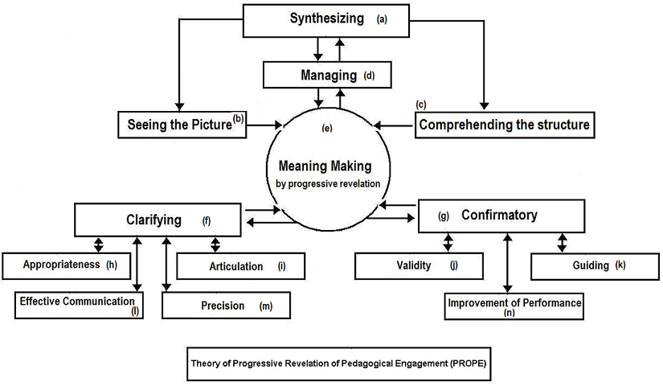
*propositions were synthesized into a substantive theory
The three emerged propositions were synthesized into a substantive theory of pedagogy (PROPE) that underpins VET teaching.

Slide 19
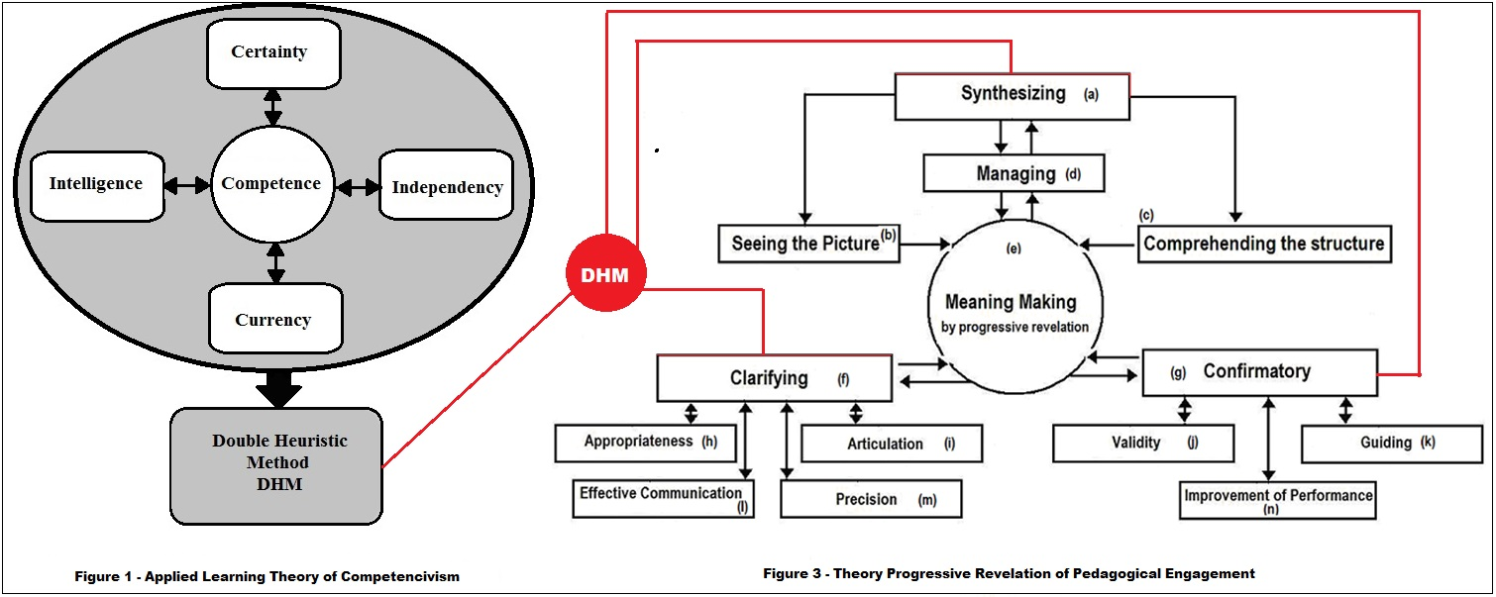

Slide 20
Evidence
The data collected evidence indicated satisfaction among participating teachers and was reported in three chapters (over 45 pages). Few examples are listed as follows:
“The DHM framework assists me in my decision-making both theoretically and practically.” “The DHM provides a pathway from theoretical to practical application of VET delivery, a pathway for analyzing and improving an existing application.
“I think the DHM is very important. I think that is where you work at your delivery methods and strategies”
“The DHM Model allows me to think about my subject, allows me to be more precise in picking up what I am going to teach in theory and how I am going to do it in practice.”

Slide 21
Further Evidence
“Because the relationships of skills and knowledge to other concepts are meaningfully established in the DHM, I have been able to produce meaningful resources comprised of meaningful learning experiences for my students.
I have received feedback from these students that are indicative of such an outcome.”
“Using the DHM, you got the knowledge and skills, then you are applying these to the real teaching that can be crafted into a meaningful experience … ”

Slide 22
*Implications
There is a need for a complete pedagogical revision and understanding of the delivery of programs that develop competence based on the theory of Progressive Revelations of Pedagogical Engagement (PROPE)
There is a need for developing greater clarity for teachers and students in engaging with the inter-relationships of the components in Units of Competency of the Training Packages, through the use of a pedagogical framework, namely the DHM
There is a need for holistic assessments in Training Packages context where the knowledge, skills and performance criteria are holistically tested and marked. The DHM allows this to happen.
Teaching, learning and assessment in the VET sector require a solid theoretical framework and vehicle to equip teachers. The theory of Applied Learning of Competencivism and DHM fulfil this need.

Slide 23
Completion Rates

Slide 24
Completion rates are low
Completion Rate is ” the proportion of people who finish a qualification they started”. (NCVER, 2013)
In 2010 that figure was about 27.10%
“Unsurprisingly, completion rates are very low”. (CEDA, 2016)
“Even more alarmingly, the quality of provision in some of these for-profit providers has been so low that regulators have actually, revoked qualifications.” (CEDA, 2016)
Only 7 per cent of online students have completed their courses between 2010 and 2013 (training website, 2015)
Students who attend FTF only 40 per cent complete (training website, 2015)

Slide 25
In 2009, Aiming at Higher Completion Rates paper concluded that,
“Attributes are the heart intelligence of Competency development and need to be emphasized, not only in the apprenticeship and traineeship programs, but across VET.
Without developing the heart intelligence of competency, i. e. , the attributes, by the learners, not only will the completion rates continue to decline but, also, the productivity of the graduates on the job after the completion of studies will be poor.” (Azemikhah, 2009)

Slide 26
Create Your Mental GPS with Competency Intelligence
As the low level of completion was continuously problematic for VET students since 2009, the findings of this research were utilized in writing of a book, entitled, “Create Your Mental GPS with Competency Intelligence” to encourage students to achieve their dreams.

Slide 27
Personal attributes are Hallmarks of Achievement (2009)
In 2009 paper we emphasized:
personal and social skills,
life-long learning skills,
emotional balance,
linking desires to emotions,
commitment,
motivation,
attributes of desiring success, achievement and that
the focus, needs to be placed on, “personal and social skills, personal attributes as the hallmarks of achievement leading to higher completion rates”.

Slide 28
premise of intelligence confirmed again by CEDA (2016)
CEDA report (2016:10) has further emphasised the importance of creativity, social intelligence, patience, critical thinking and resilience.
While patience and resilience may be regarded as part of emotional competences (EQ)
the Creativity and critical thinking is part of intellectual intelligence (IQ).
These references confirm the premise of intelligence in Competencivism (Azemikhah, 2013:111). Utilizing the notion of ICEQ is to blend intellectual abilities (IQ) such as creativity, critical thinking with emotional competences such as social intelligence abilities, patience and resilience (EQ).
Hence, the student’s agreement with himself/ herself to develop and apply the competency intelligence (CQ) that connects his/her IQ to his/her EQ is vital.

Slide 29
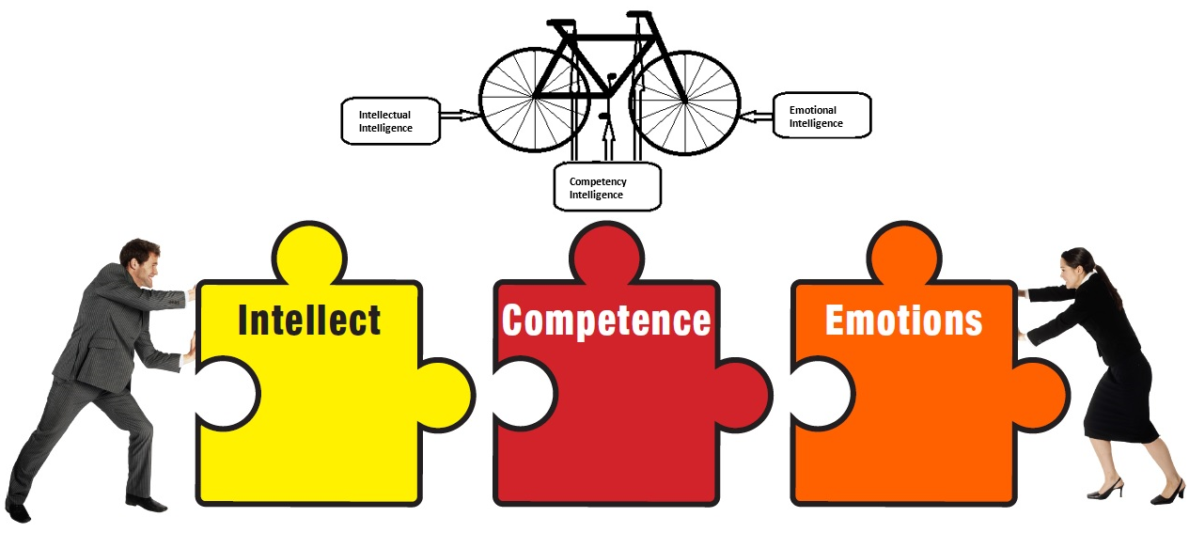

Slide 30
VET’s pedagogical twins
The Australian Oxford Dictionary defines intelligence as “the power of learning” and as “gaining knowledge or skills by study or experience or by being taught.”
, a search on the Internet returned “ability to acquire and apply knowledge and skills.” Who is an eminent person of great intelligence? An Internet search yielded the following: “a person or being with the ability to acquire and apply knowledge and skills.
Compare this finding with the definition of competence provided by Australian National Quality Council (2009:6) “Competence is the consistent application of knowledge and skills to performance.”
The new insight is that competence and intelligence are VET’s pedagogical twins

Slide 31
Comparing intelligence and competence
Intelligence
Competence
The Australian Oxford Dictionary defines intelligence as “the power of learning” and as “gaining knowledge or skills by study or experience or by being taught.”
, a search on the Internet returned “ability to acquire and apply knowledge and skills.” Who is an eminent person of great intelligence?
An Internet search yielded the following: “a person or being with the ability to acquire and apply knowledge and skills.
Definition of competence provided by Australian National Quality Council (2009:6)
“Competence is the consistent application of knowledge and skills to performance.”

Slide 32
the only move forward for VET pedagogy
.Hence, the only move forward for VET pedagogy is to synthesize both, i.e., competence and intelligence to boost completion of studies.
Their synthesis adds value to VET pedagogy.
VET pedagogy must be reformed based on this synthesis to address the low level of completion rates and to achieve a higher quality teaching and learning.
This view of VET pedagogy is detailed in, “Create Your Mental GPS with Competency Intelligence”

Slide 33
Create your mental GPS to complete your studies
Create Your Mental GPS is based on the findings of the research and:
It was designed to help students to plan and realize their dreams of completion of studies.
It also assists teachers to plan and deliver the units of competency of the Training Packages based on the new pedagogy of competence and intelligence.
Its main aim is to stop the process of procrastination, encouraging students to achieve their goals and realize their dreams.
It is aimed to help the students who tend to quit or drop their courses.
It helps the readers to see their goals as destinations in their mind and develop a plan of action based on the DHM to arrive at their destinations by creating a mental GPS.
By creating a mental GPS, the students are able to plan and achieve their completion of studies.

Slide 34
Create Your Mental GPS! What it does?
It reverses the process of decline in achievement of goals (Completion of studies) in life.
It follows the 2009 AVETRA paper
It not only helps students but every human being to realize their dreams.
It explains how you can incorporate emotional intelligence and personal attributes in what you intend to achieve.
It is a must read for every student , every teacher and every human being on the planet who intends to reach to their destinations in their life.
It contains many secret links that students will discover as they read.

Slide 35
Students can rid themselves of the imbalances
The imbalances in the areas of life that may contribute to the following feelings:
Hopelessness to complete your studies,
lack of concentration and focus,
Not knowing what to do next,
Lack of certainty and confidence in life,
Feeling lost in life,
Not interested in setting goals,
Feeling of Incompetence,
Feeling emotionally low or
Feelings of failure to live a fulfilling life.

Slide 36
Conclusion and evolution of vet pedagogy
The aim of this research was to investigate how teachers in Vocational Education and Training (VET) in Australia deal with the Double Heuristic Method (DHM) as an alternative model of pedagogy for teaching in the VET Sector.
The inquiry was designed within an interpretive paradigm in seeking to capture VET teachers’ perspectives on adopting the DHM as an innovative model of pedagogy
It concluded by synthesizing the three emerged propositions into a substantive theory of pedagogy (PROPE) that underpins VET teaching.

Slide 37
Competency Intelligence Based Training (CIBT)
Given that VET pedagogy needs to be reformed based on the synthesis of competence and intelligence to achieve higher quality teaching and learning as well as higher level of completion rates,
Competency Based Training (CBT) as the foundation of VET pedagogy needs to be evolved into Competency Intelligence Based Training (CIBT).
To make VET great again we need a strong VET erected on the evolving CIBT foundation.

