Slide 1
Engaging youth with careers information: The risks and benefits of engagement platforms
Peta Skujins
Australian Apprenticeships & Traineeships Information Service
Notes:
There are a myriad of ways to access information about careers, including education pathways and the labour market. This research investigated the mechanisms and platforms used by young Australians and their influencers to access careers information, and the risks and benefits of this.
The research showed discrepancies between the ways young people access careers information and the ways influencers believe they do. There are further discrepancies between sources that youth report as helpful and what influencers believe youth should use, meaning that young people are often encouraged to use information sources that are not benefiting them.
There are risks and benefits to accessing careers information through all mechanisms, including through conversations with others, online, and through social media. Young people report needing more support to understand the types of careers information available, and this information needs to be presented in a form that they can easily use.

Slide 2
About AATIS
Australian Apprenticeships and Traineeships Information Service
Funded by the Australian Government Department of Education and Training
Services include: AAPathways website, AusAppPathways mobile app, MyGain YouTube channel, Free Call line, and social media presence

Slide 3
When you think of Facebook you think of a bunch of opinionated people, but Google you just Google it.

Slide 4
Education and Employment Trends
Full time employment has declined while part time and casual employment has increased
Participation in schooling has increased
Participation and attainment of post-school qualifications has increased
Participation in Australian Apprenticeships has decreased
1/8 young people who leave school early will never complete year 12 or certificate II or higher
70% of jobs that young people traditionally enter will be affected by automation
Young people will have 17 jobs over 5 careers

Slide 5
Setting up a new career, finding out all you need to know before you start.

Slide 6
Influencers: What is career information?
flyers or handouts that have information on them, also speaking to a career adviser
on-line tools and assessments
all published information available through every media format, it also includes personal experiences and family experiences
currently dominated by university marketing
formal and informal information… case studies, experiences
Must be a combination of formal information… and experiential activities

Slide 7
Youth: What is career information?
how much you get paid
what can you do without your Ps?
whatever my job person tells me
looking at SEEK and Indeed
putting stuff on your resume but then the boss finds out and you get sacked
my friends sister helped me write my resume, ‘cos she’s good at that
work experience is pretty good, but you can’t find a job and you don’t get paid for it

Slide 8
Printed materials

Slide 9
Printed materials
Notes:
All significant at p<.01

Slide 10
Printed materials
Notes:
Difference for ‘helpful’ all significant at p<.01

Slide 11
Printed materials
Notes:
Difference between youth use and influencers think youth significant at p<.01 for flyers and fact sheets, non-significant (p=.3) for information packs

Slide 12
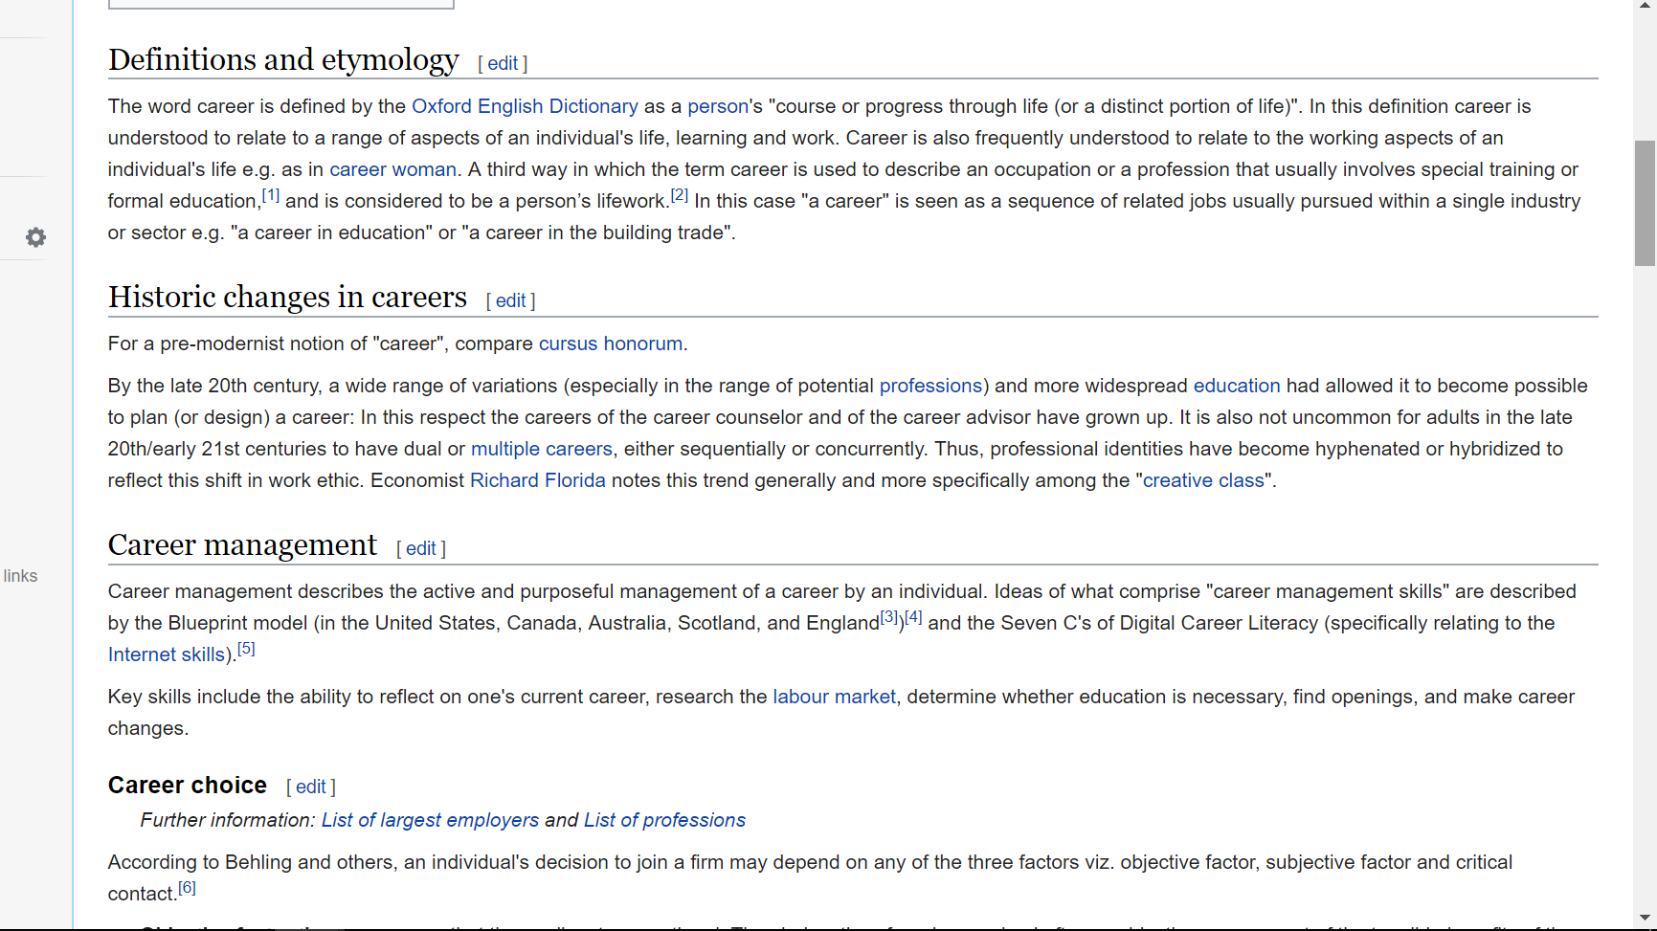
Web platforms

Slide 13
Web platforms
Notes:
All significant at p<.001

Slide 14
Web platforms
Notes:
Difference in ‘helpful’ significant at p<.001 for Newsletters and Quizzes, non-significant for Blogs (p=.97)

Slide 15
Web platforms
Notes:
Difference between youth use and influencers think youth use all significant at p<.001

Slide 16
Social media

Slide 17
Social media
Notes:
Significant difference at p<.05 for Facebook and p<.001 for YouTube, non-significant for Snapchat (p=.68)

Slide 18
Social media
Notes:
Difference between ‘helpful’ significant at p<.01 for YouTube and Snapchat, non-significant for Facebook (p=.17)

Slide 19
Social media
Notes:
Difference between youth use and influencers think youth should use all significant at p<.001

Slide 20
The only person you’ve got is yourself.

Slide 21
Who do youth talk to?

Slide 22
I find that parents, because they know you so well, when you suggest jobs they might actually know If it might suit you.

Slide 23
What do young people hate?
Leaflets: get lost and don’t have real information
Websites: large blocks of text, loops you back through without an answer
Social media: outdated memes, ads
Booklets: leaflets get lost and don’t have enough information
Websites: information is easy to find and easy to read
Social media: something that shows you are a reputable source

Slide 24
What do young people hate?
Leaflets: get lost and don’t have real information
Websites: large blocks of text, loops you back through without an answer
Social media: outdated memes, ads
Booklets: compile information and like having something given to them
Websites: information is easy to find and easy to read
Social media: something that shows you are a reputable source
What do young people like?

Slide 25
I already know what I’m going to do in the future, my pathway and stuff.
Notes:
All of the italics on these slides are direct quotes from the young people in our focus groups.

Slide 26
What are the problems?
Young people have a narrow view of what careers information is
Influencers and information providers incorrectly assume youth already use these platforms
Influencers don’t think these platforms are useful themselves
Youth prefer talking with parents and friends about careers
Online information isn’t suitable for may groups of young people

Slide 27
You don’t know what you don’t know

Slide 28
Your home of information
Free call 1800 338 022
contact@aatis.com.au

