Slide 1
The TAFE-Industry nexus
Developing collaborative proposals for applied research
Dr. Henry Pook

Slide 2
The workshop: developing proposals for applied research
Why work with industry on applied research?
Who are our industry partners? How do we develop partnerships with industry?
How is an applied research project developed?

Slide 3
Firstly- a profile of our workshop participants
Your industry sector?-Business; Business Development; Building; Community Services; Design; Education and Training; Fitness; Health; Horticulture/Environment; Hospitality; IT.
Your organisation?-Does it conduct applied research? Is it captured in a strategic plan? How is it carried out-project, individual, class based?
Is industry involved in applied research? How?

Slide 4
Applied Research: what is it?
Research and Innovation
Organisational change
Changes to work processes
Testing product for industry
Revised training to introduce these improvements
applied research: the systematic application of existing or new research/knowledge to the production/improvement of new materials, products, services, devices, policies or systems.

Slide 5
Universities and TAFE
A study of two systems

Slide 6
Universities Australia and ‘Clever Collaborations’
University applied research and industry
‘( Universities)…are a vast resource of research and innovation for both business and community groups.’
‘…if you have a complex challenge…come and talk to one of Australia’s world class universities about how we can work together.’
(Universities Australia, Clever Collaborations, p.5 )

Slide 7
TAFE applied research and industry: the scope for ‘clever collaborations’?
TAFE prides itself on past collaborations with employers, industry and professional bodies, Commonwealth and State Governments and local communities.
Policy imperative to further applied research and to establish industry partnerships and collaborations to help secure the future of vocational education and training

Slide 8
Why work with industry on applied research?
How does it benefit TAFE?
Some thoughts…

Slide 9
What some of the benefits?
course development, staff development through engagement with the research and innovation process,
development of student skills and capabilities as a consequence through: work with research projects, exposure to ‘real work’, and the development of investigative and entrepreneurial skills.
effective promotion and publication of research efforts contributes to research profile that has the potential to enhance TAFE’s standing: to provide a ‘leading edge’.
other? financial support for an Institute?

Slide 10
Partnering with industry
Who are our industry partners?
How do we develop partnerships with industry?

Slide 11
Industry and community partners
Applied research will be supported by collaborations and partnerships with industry, tertiary education providers and the community.
Institute
industry
government and community
SMEs
University/ other education research partners

Slide 12
Exercise 1: Industry and community partners
Can you identify examples from each of the four categories that apply to your industry/discipline area?
What might these institutions be looking for in a research partner from TAFE?
What can they be expected to bring to the partnership? (e.g. funding, technical expertise, eligibility for research funding)
What can TAFE offer?

Slide 13
Developing partnerships-a how to guide (?)
Suggestions…?
Develop and strengthening partnerships: active intervention from course leaders/industry liaison staff (industry visits, industry breakfasts)
Establish research advisory bodies: secure the services of industry and professional leaders
Facilitate industry mentorship and information-sharing;
Seek support for jointly financed shared adjunct appointments or between TAFE and industry;
Source sponsorship funds for research and innovation projects; and
Ensure that the partnership is maintained.

Slide 14
Developing a research proposal
How is a research proposal developed?

Slide 15
Exercise 2-Developing applied research proposals with industry
What is the potential for applied research in collaboration with external partners in your faculty and /or department? What has been done already?
Barriers to developing applied research projects with industry or other external partners? How might these potential barriers be overcome?
Getting started… assume you have a partner-what are the steps to develop a research proposal?

Slide 16
Exercise 3. Developing the proposal: some initial steps
  Determine a key question and the target of the research.
Characterise your group’s proposed research in terms of: key questions, potential interested parties, likely competitors, expected outcomes.
Identify resources needed: develop a resource list for your field of interest in terms of: journals, databases and other materials.
Do we have the necessary expertise to undertake such a study:
e.g. journals; web resources; facilities, and equipment?

Slide 17
Developing a written proposal
Identify the project’s objective and the key issue or problem it would investigate. Resolve IP issues
Outline the nature of the research collaboration, including information about proposed project, e.g. is it research and development or innovation (e.g. work process), the testing or validation of a product,
Determine whether student involvement is required or available, e.g. placement or internship.
Suggest benefits (i.e. outcomes) and challenges that such a project would bring to the company or organisation
Resources that the company or organisation might provide in support of the project
When would the project commence and when would it be completed?

Slide 18
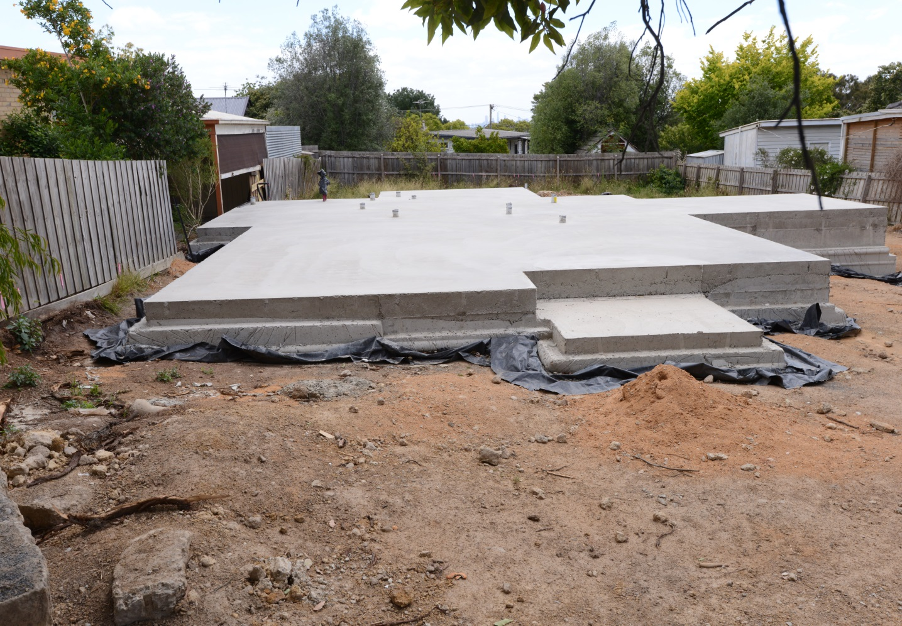
Case study-Partnering with industry: evolution of an applied research project
Industry problem-challenge to forest and wood products industry from pre-fabricated or alternative products-concrete slabs in place of timber floors and steel framing in place of timber.

Slide 19
Partnering with industry: evolution of an applied research project
Industry response
Research project to develop an alternative to concrete slabs that could be used across a range of conditions. Design and build a systems based, pre-fabricated ground floor system

Slide 20
Developing the proposal
Partnerships: truss and frame manufacturers, industry councils, design companies, TAFE
Resources: direct funding, building research laboratory, in-kind industry support
Research team:
design company
building research laboratory laboratory
TAFE-provision of technical expertise
Builder-installation of prototype on site

Slide 21
Cycle of applied research and development
Problem identified
Partnerships established
Testing and modification of original design
Build prototype
Construction and installation of final product
Knowledge sharing and technology transfer
Modular flooring: the process

Slide 22
The workshop: applied research and industry projects- a re-cap
Questions to consider…
What is the potential for applied research and innovation projects in collaboration with external partners in your faculty and /or department? What has been done already?
Are there barriers to developing applied research projects with industry or other external partners? How might these potential barriers be overcome?
How do we get started in developing applied research and innovation projects with an industry/community link? What are the steps to be taken?

